Slide 1
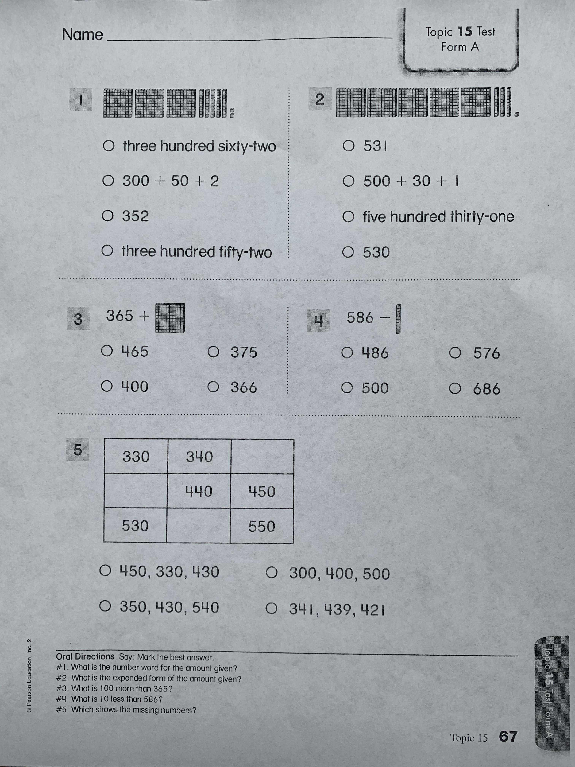
Topic 15 Test
Form A
What is the number word?
What is the expanded form?
What is 100 more?
What is 10 less?
What are the missing numbers?

Slide 2
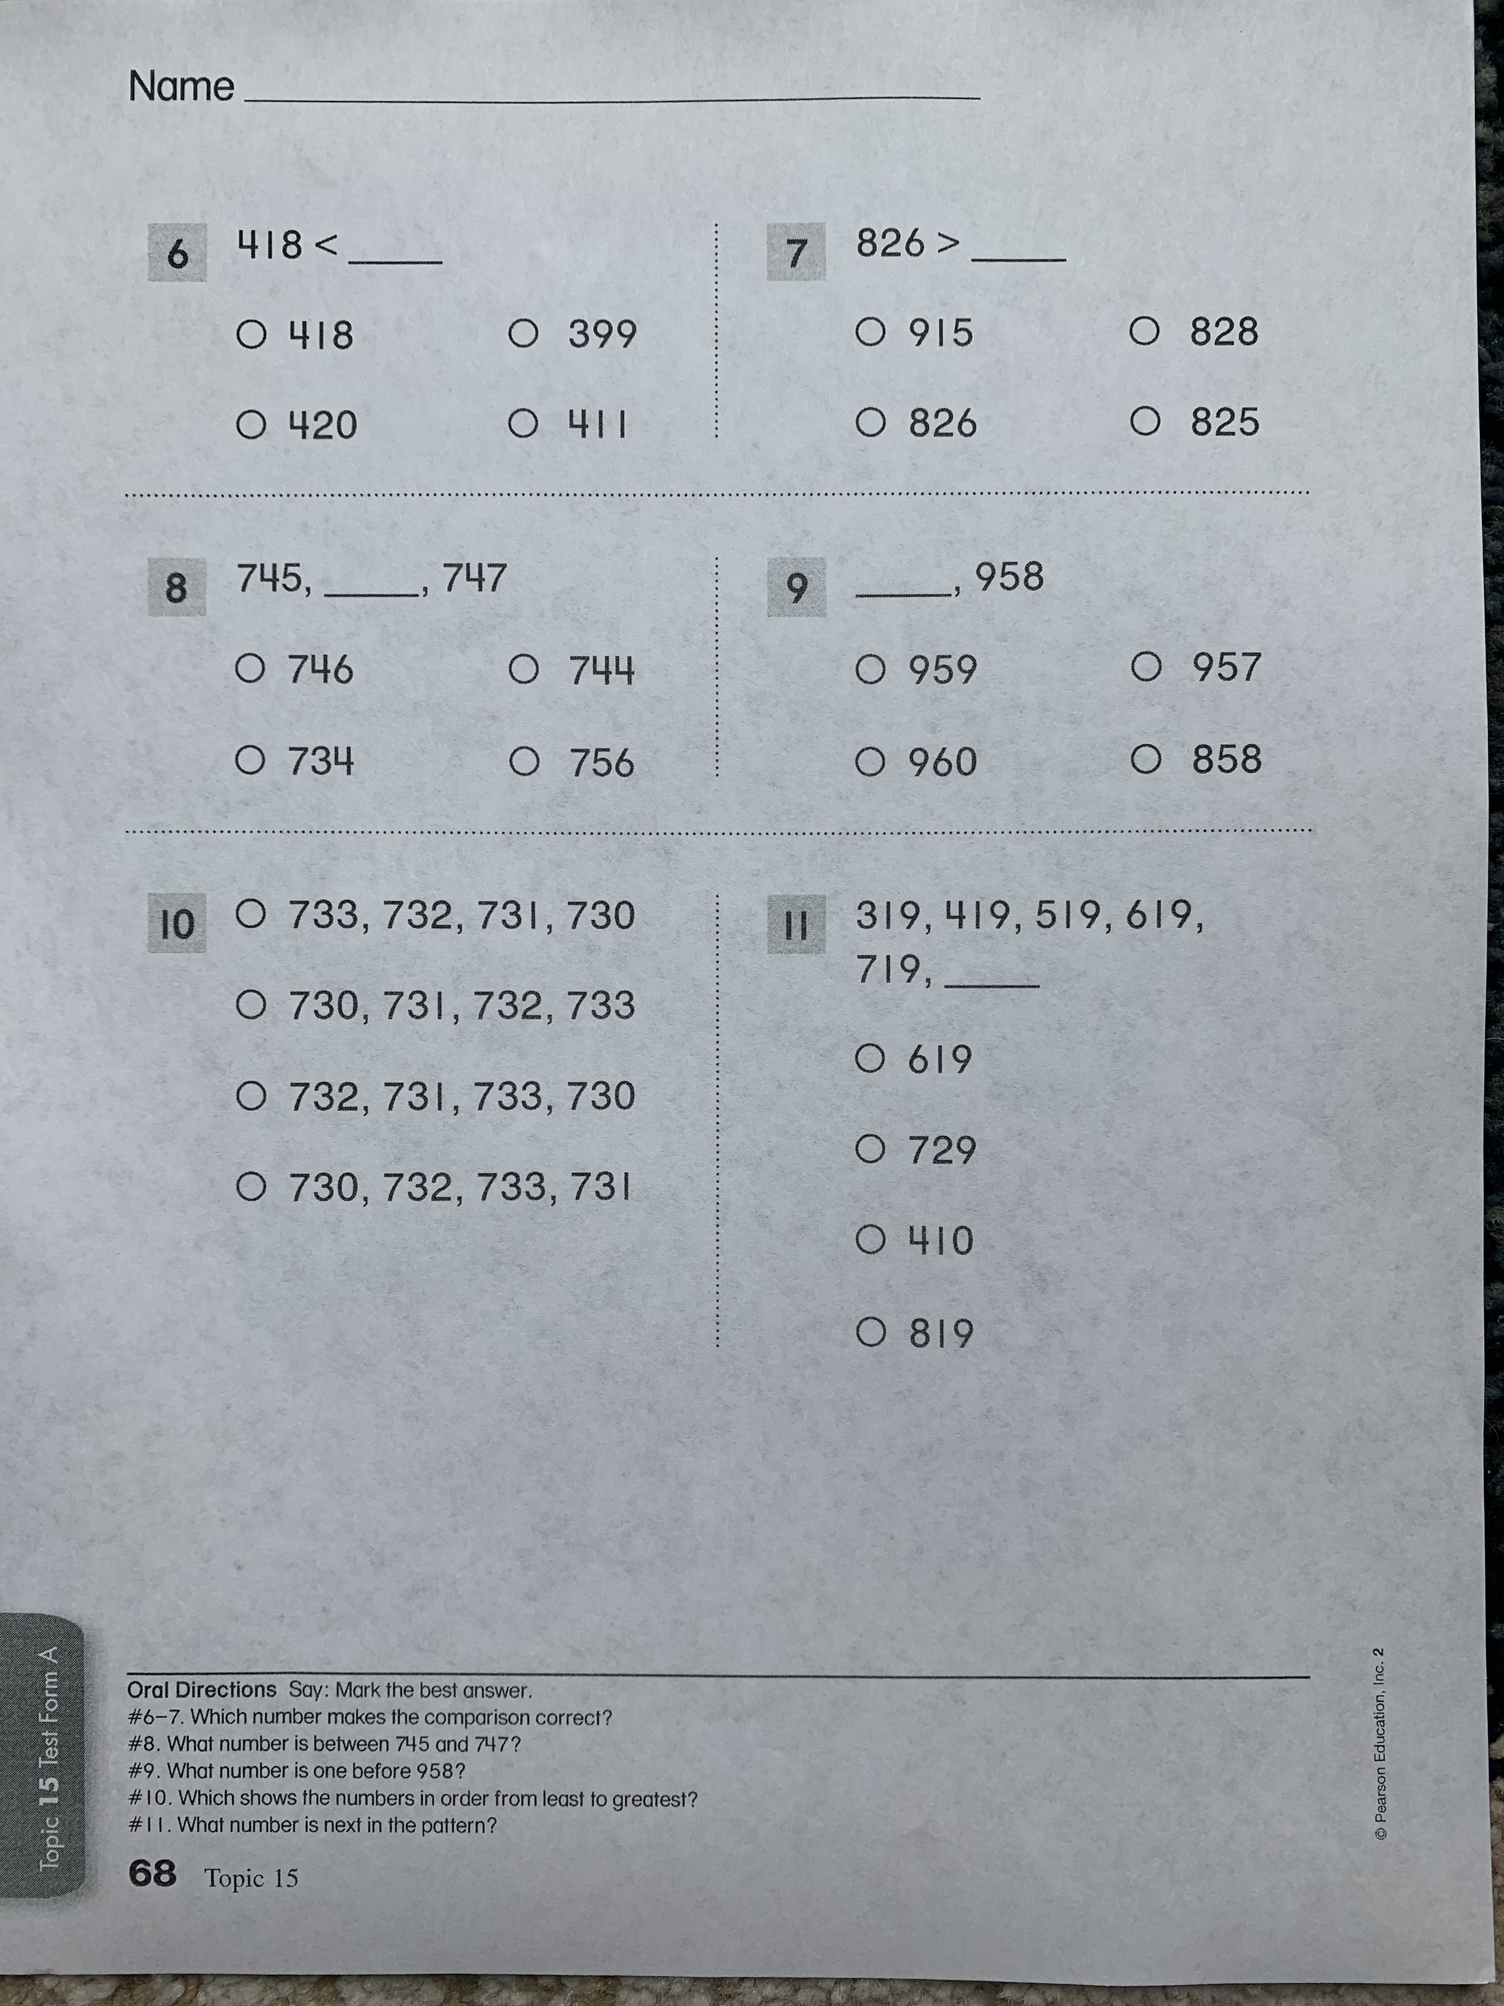
Which number makes the comparison correct?
What number is in between?
What number is one before?
Order from least to greatest.
What is next in the pattern?

Slide 3
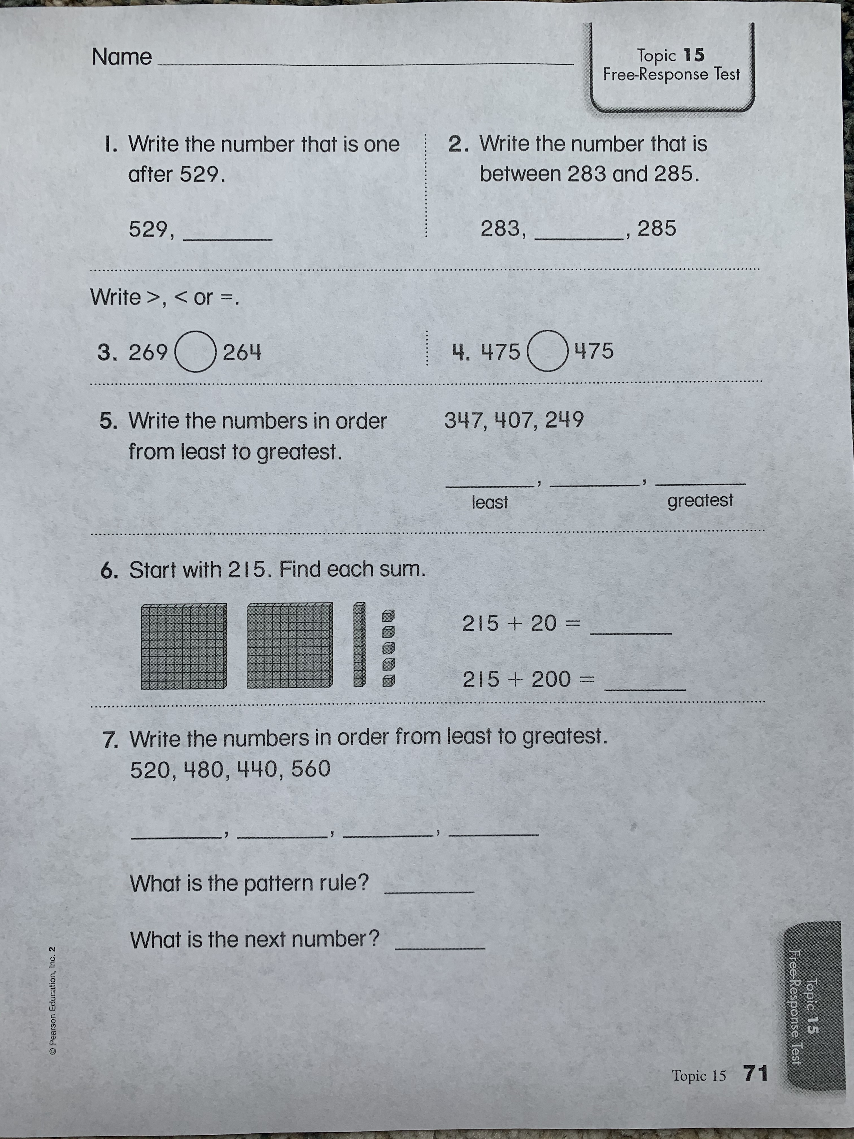
Free Response Test

Slide 4
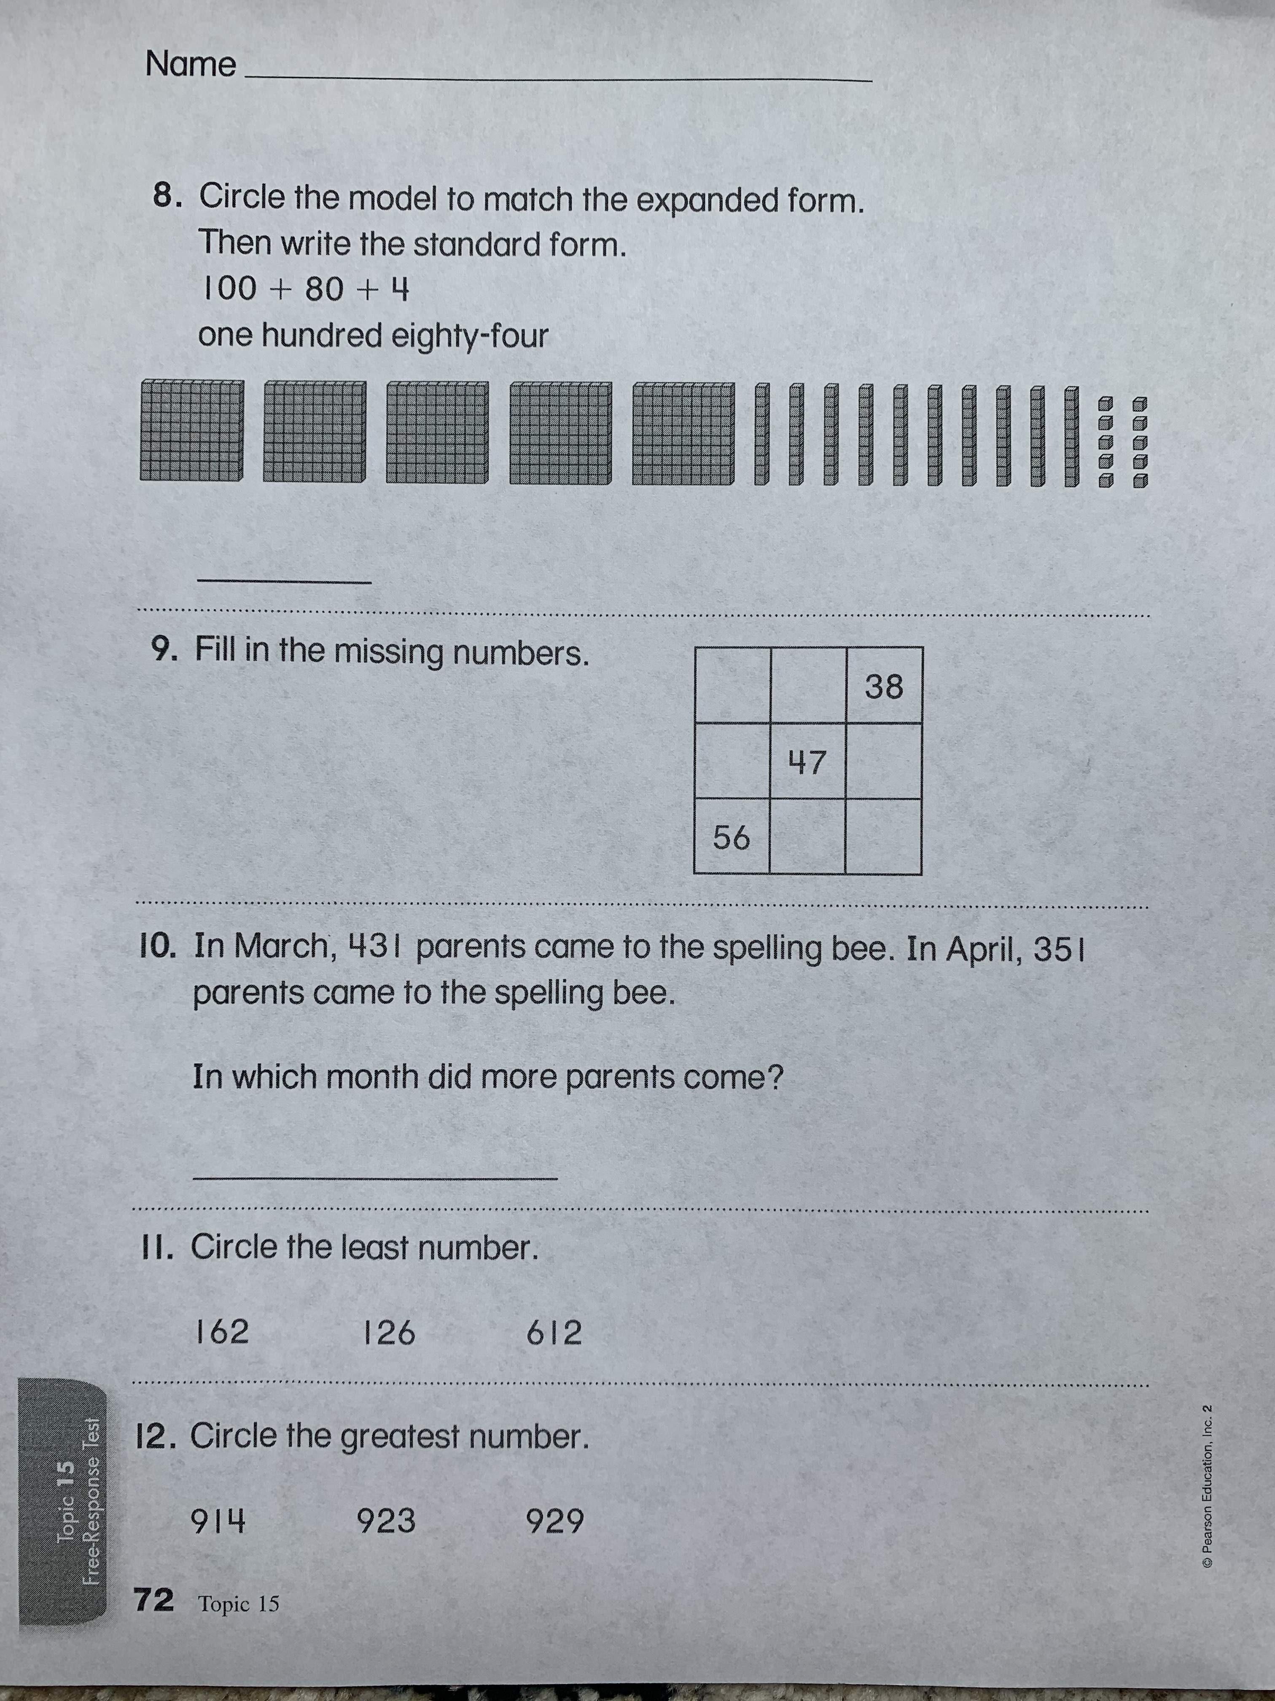
Please send pictures of your test to Ms. Lim and keep your copy. You will be grading your test and making test corrections tomorrow!

