Slide 1
15-7 Look for a Pattern

Slide 2
What is the next number in this list?
424, 324, 524, 224
Put numbers in order from least to greatest to find the pattern.

Slide 3
224, 324, 424, 524
least
greatest
The pattern rule is +100.
What is the next number?
524 +100 = 624
224, 324, 424, 524, 624

Slide 4
Let’s Practice!
523, 543, 513, 533
1. Order from least to greatest.
513, 523, 533, 543
2. What is the pattern rule?
513, 523, 533, 543
The tens increase each time, so the pattern rule is +10
3. What is the next number in this list?
543 + 10 = 553
513, 523, 533, 543, 553

Slide 5
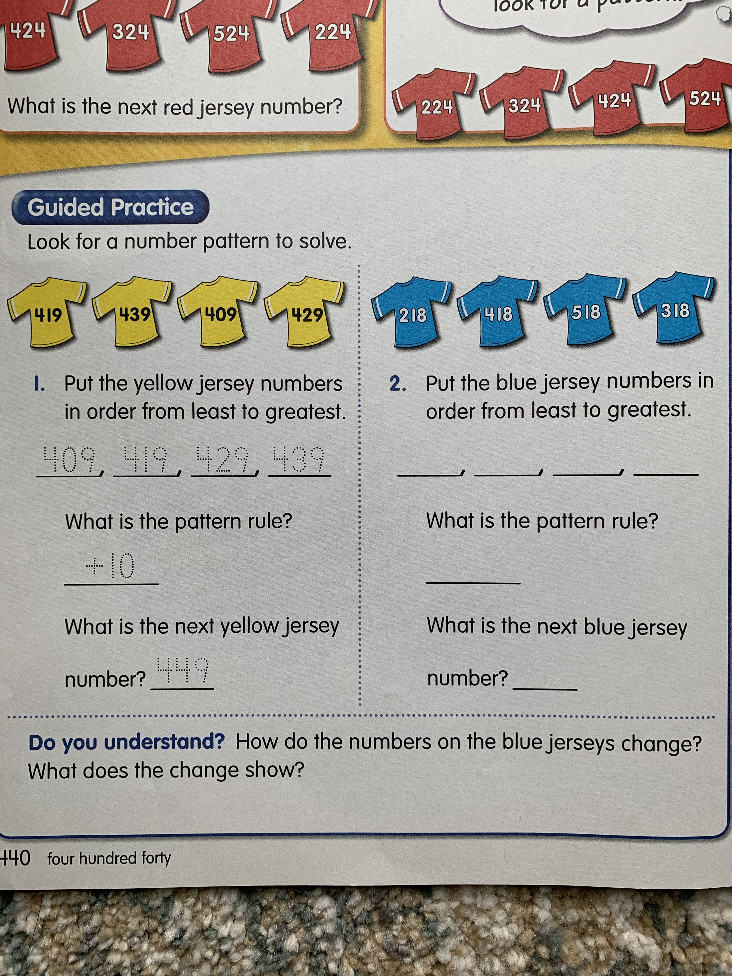
Answer these questions on a separate sheet of paper.

Slide 7
