Slide 1
15-6 Ordering Numbers

Slide 2
To Write numbers in order, first compare the hundreds digits
387 407 389
4 hundreds is greater than 3 hundreds, so 407 is the greatest number.
______ , ______ , 407
least
greatest

Slide 3
Then compare the tens digits
387 389
They are the same!
______ , ______ , 407
least
greatest

Slide 4
So now compare the ones digits
387 389
7 is less than 9,
so 387 is less than 389
387, 389, 407
least
greatest

Slide 5
Let’s practice!
Write the numbers in order from least to greatest.
254, 354, 250
______ , ______ , ______
least
greatest

Slide 6
Let’s practice!
Write the numbers in order from least to greatest.
254, 354, 250
First compare the hundreds.
3 hundreds is greater than 2 hundreds so 354 is the greatest number.
______ , ______ , 354
least
greatest

Slide 7
Let’s practice!
Write the numbers in order from least to greatest.
254, 250
Next compare the tens.
Both numbers have 5 tens! So now you have to compare the ones.
______ , ______ , 354
least
greatest

Slide 8
Let’s practice!
Write the numbers in order from least to greatest.
254, 250
0 ones is less than 4 ones, so 250 is the less than 254.
250, 254, 354
least
greatest

Slide 9
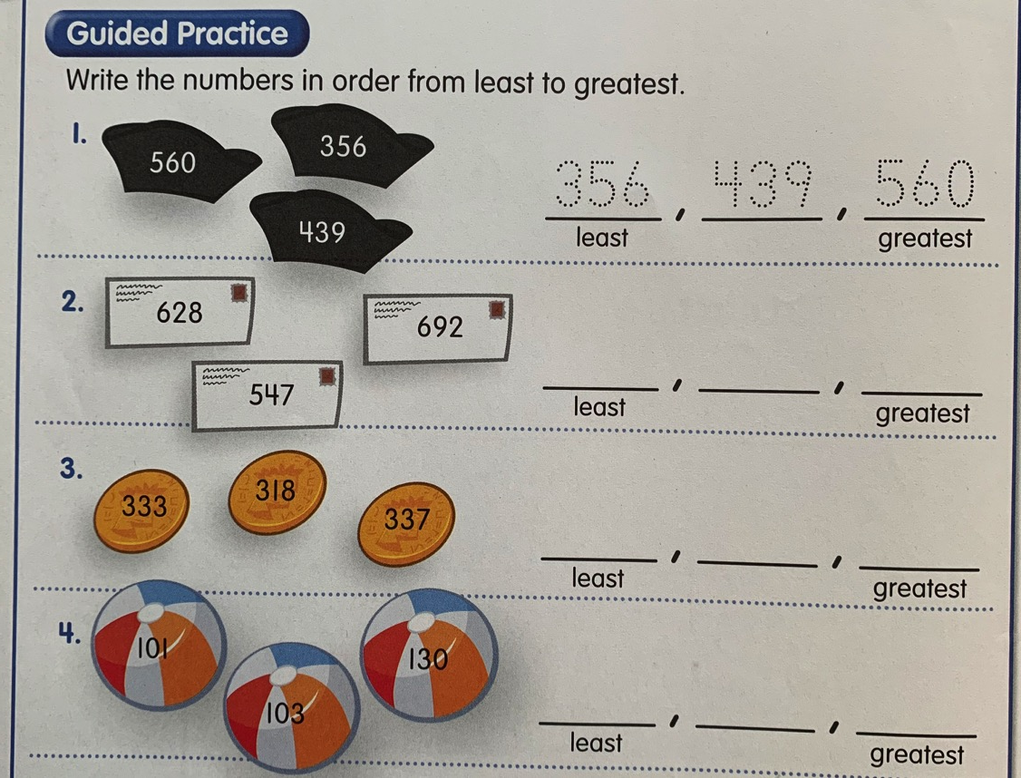
Answer these questions on a separate sheet of paper.

Slide 10
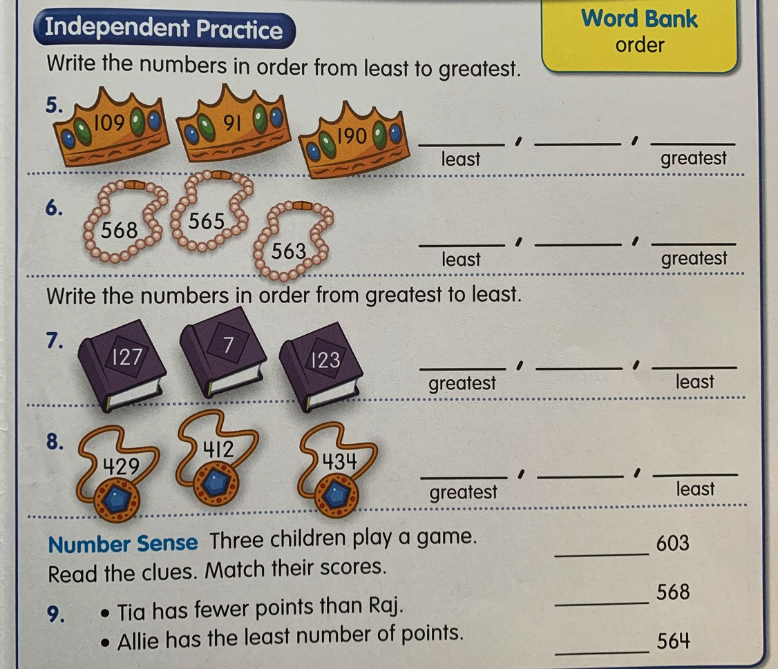

Slide 11
