Slide 1
15-5 Numbers Before, After, and Between

Slide 2
You can use before, after, and between to help find a missing number.
355 is one before 356. 355, 356
357 is one after 356. 356, 357

Slide 3
You can use before, after, and between to help find a missing number.
356 is in between 355 and 357.
324, 325, 326

Slide 4
Let’s practice!
What number is one before 546?
What number is one after 546?
What two numbers is 546 in between?

Slide 5
What number is one before 546?
545 is one before 546.
What number is one after 546?
547 is one after 546.
What two numbers is 546 in between?
546 is in between 545 and 547.

Slide 6
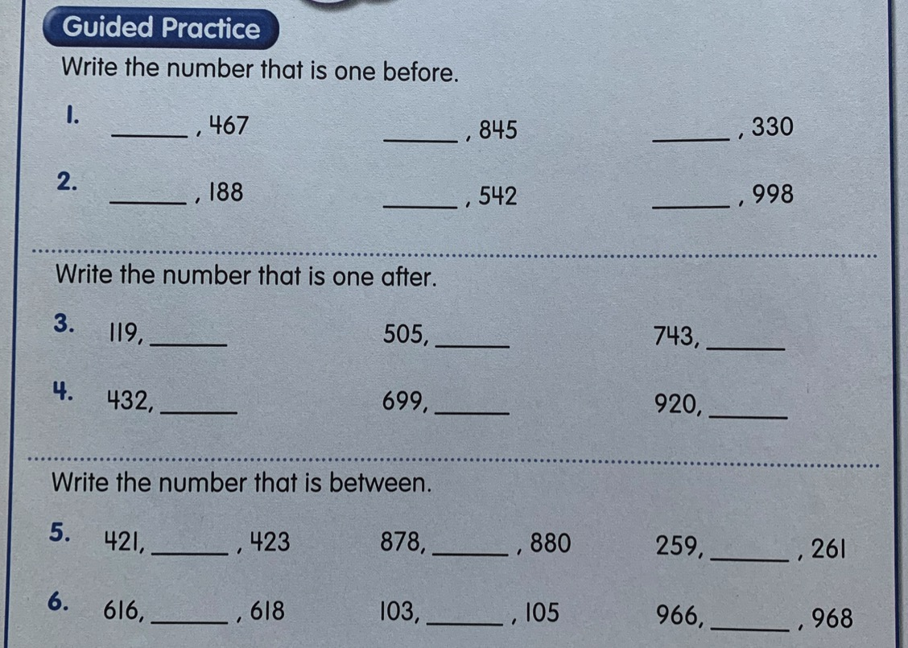
Answer these questions on a separate sheet of paper.

Slide 7
