Slide 1
15-4 Comparing Numbers

Slide 2
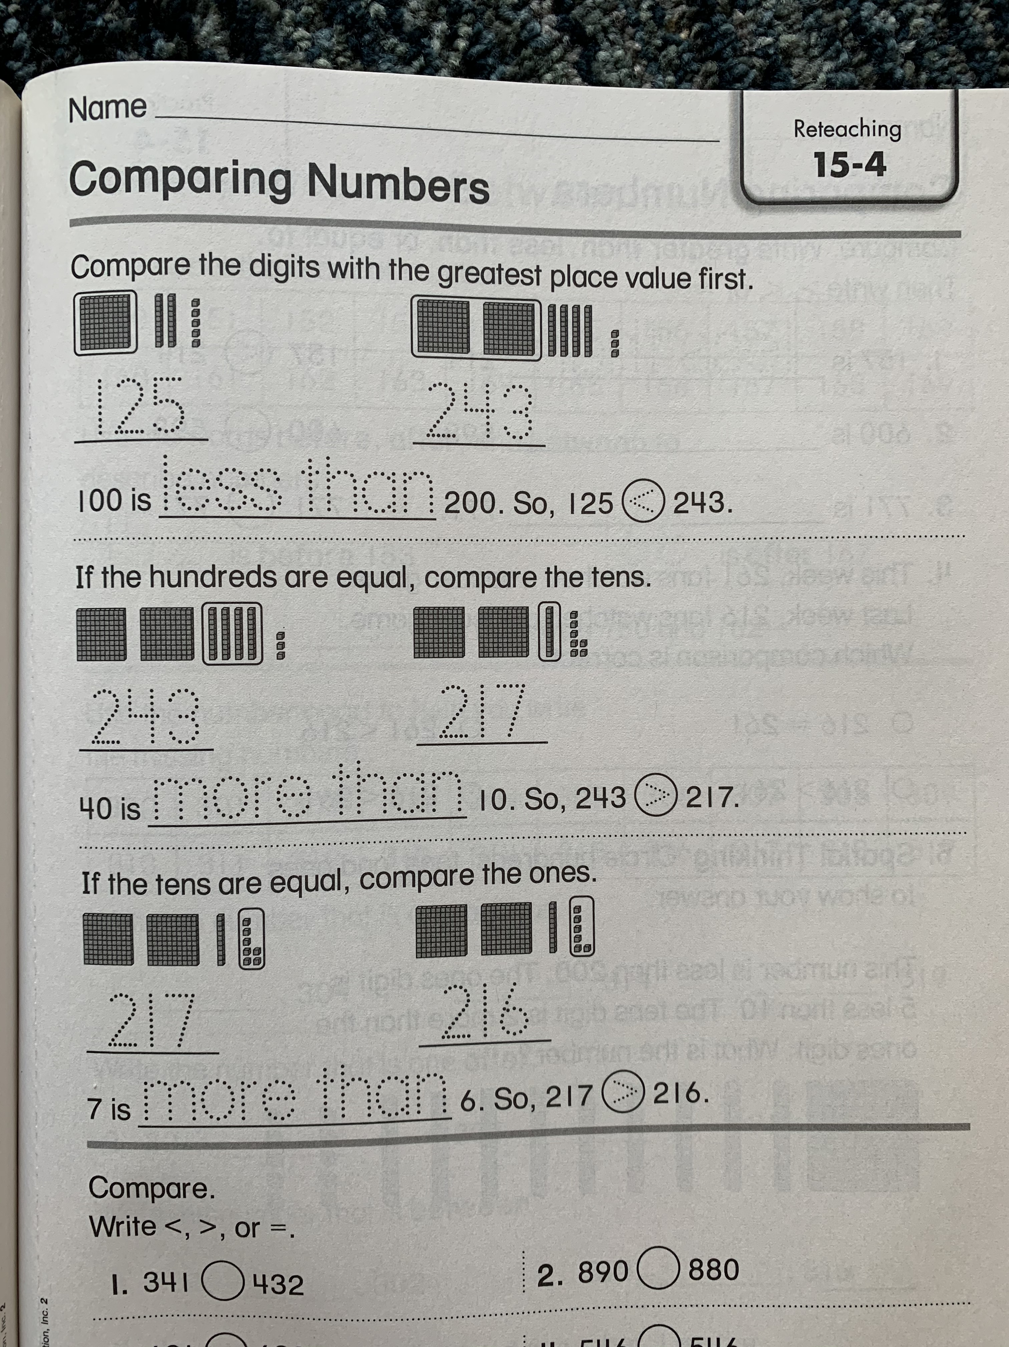
Please Read the examples.

Slide 3
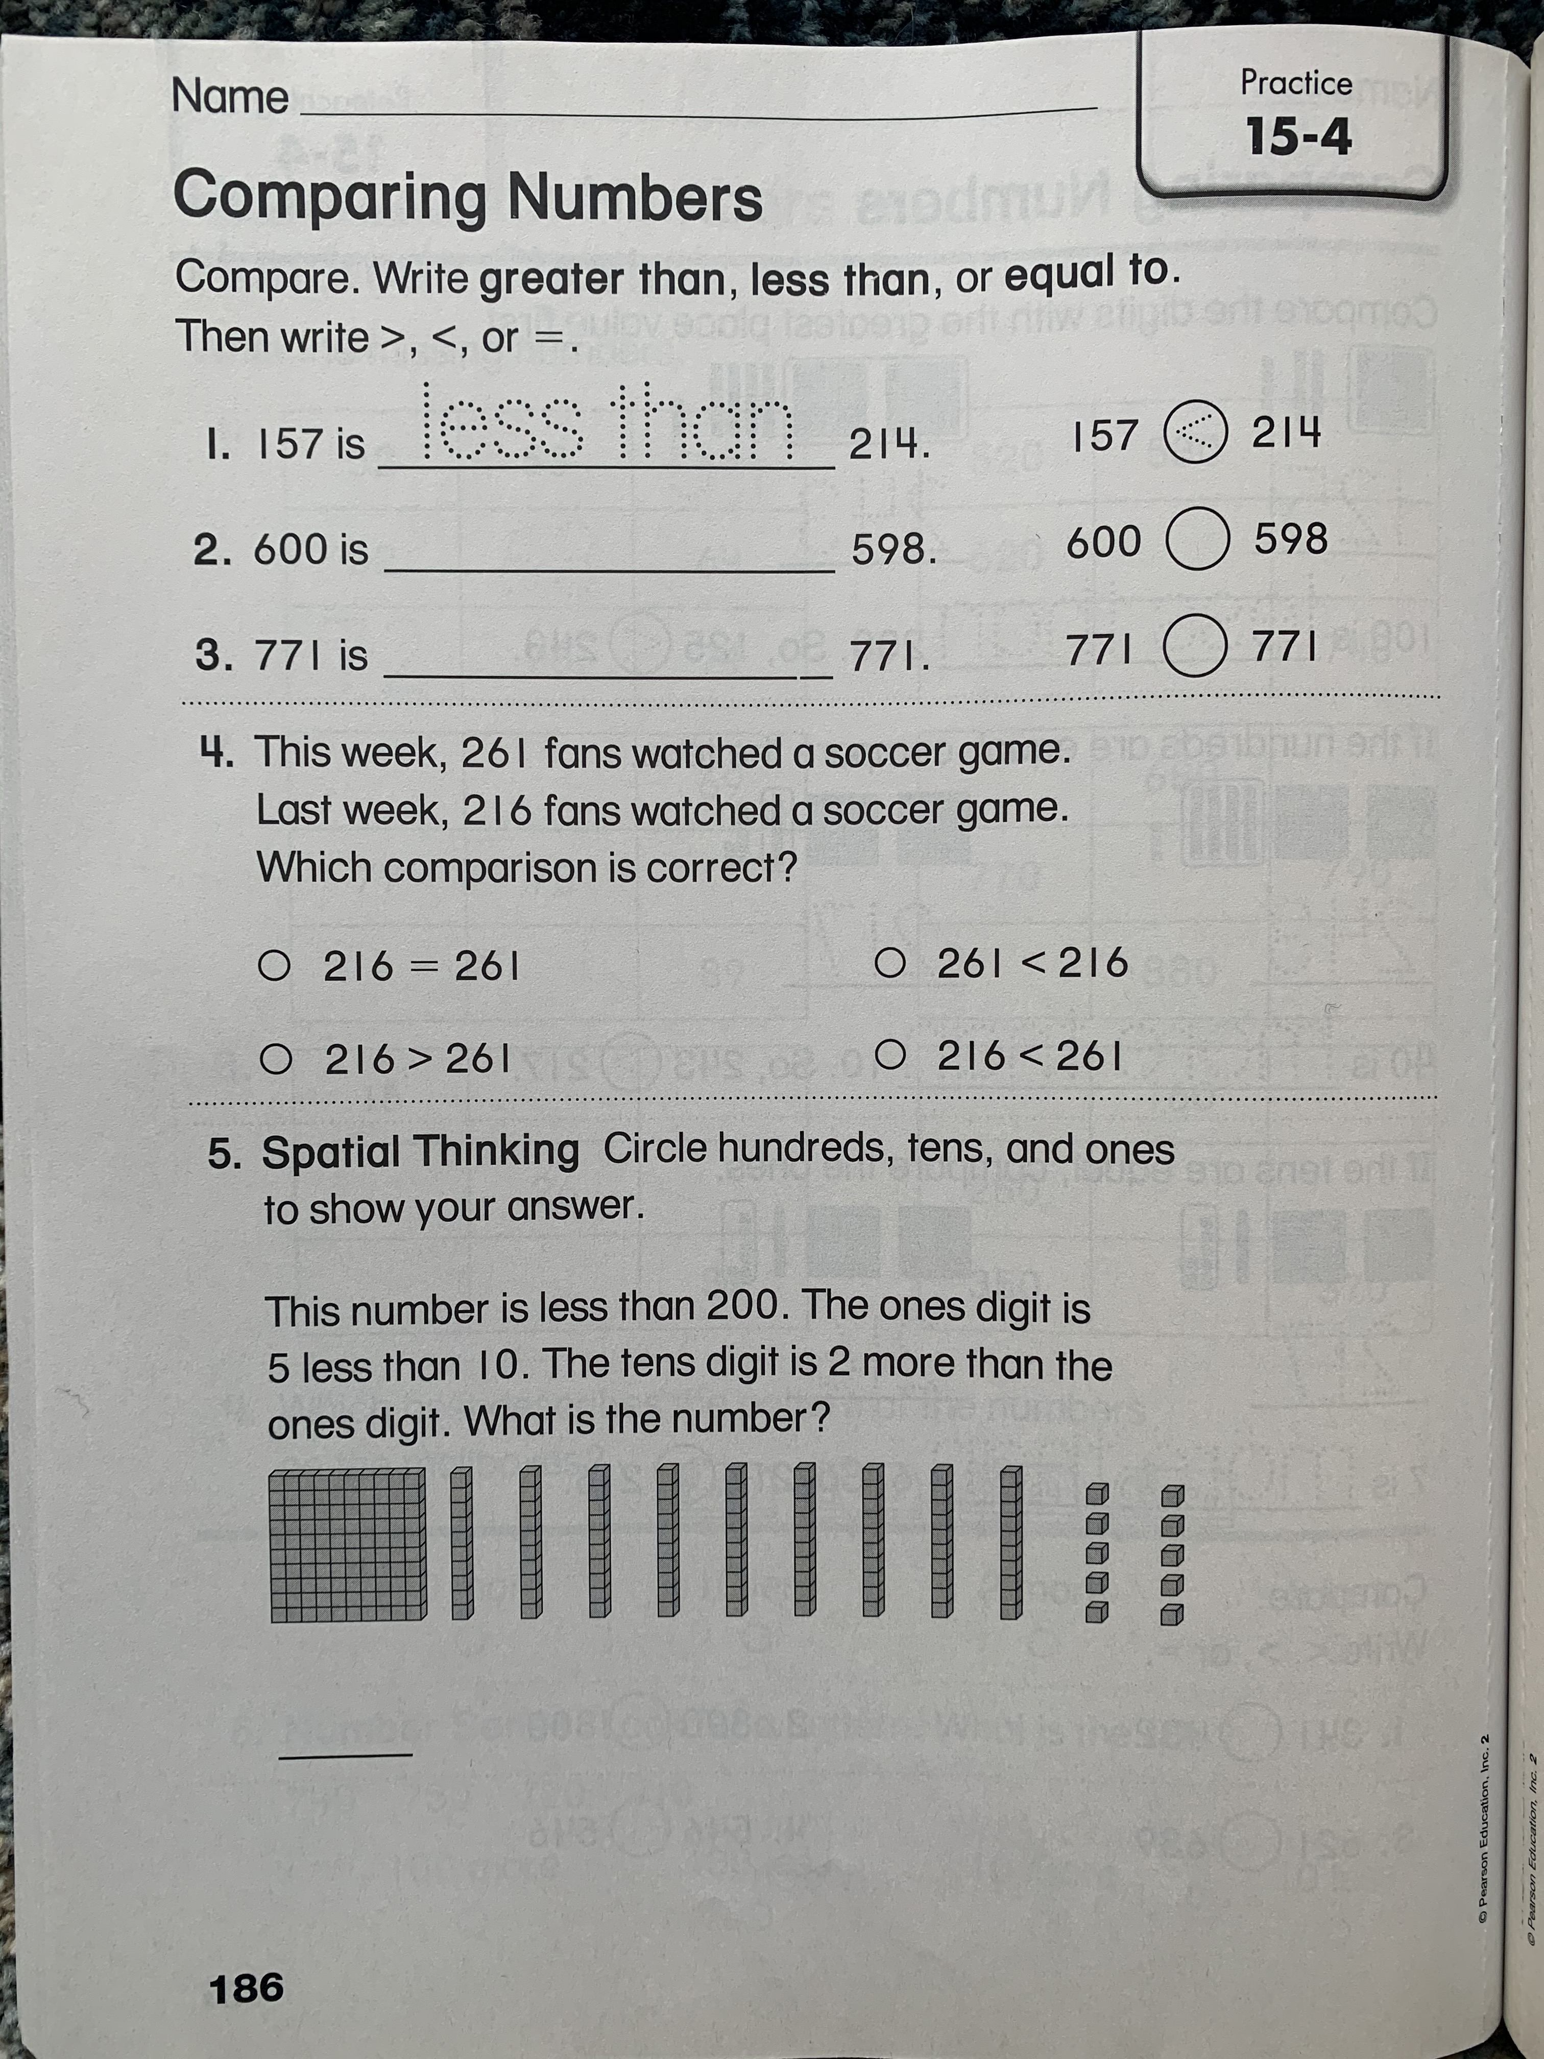
Answer these questions on a separate sheet of paper.

Slide 4
