Slide 1
15-4 Comparing Numbers

Slide 2
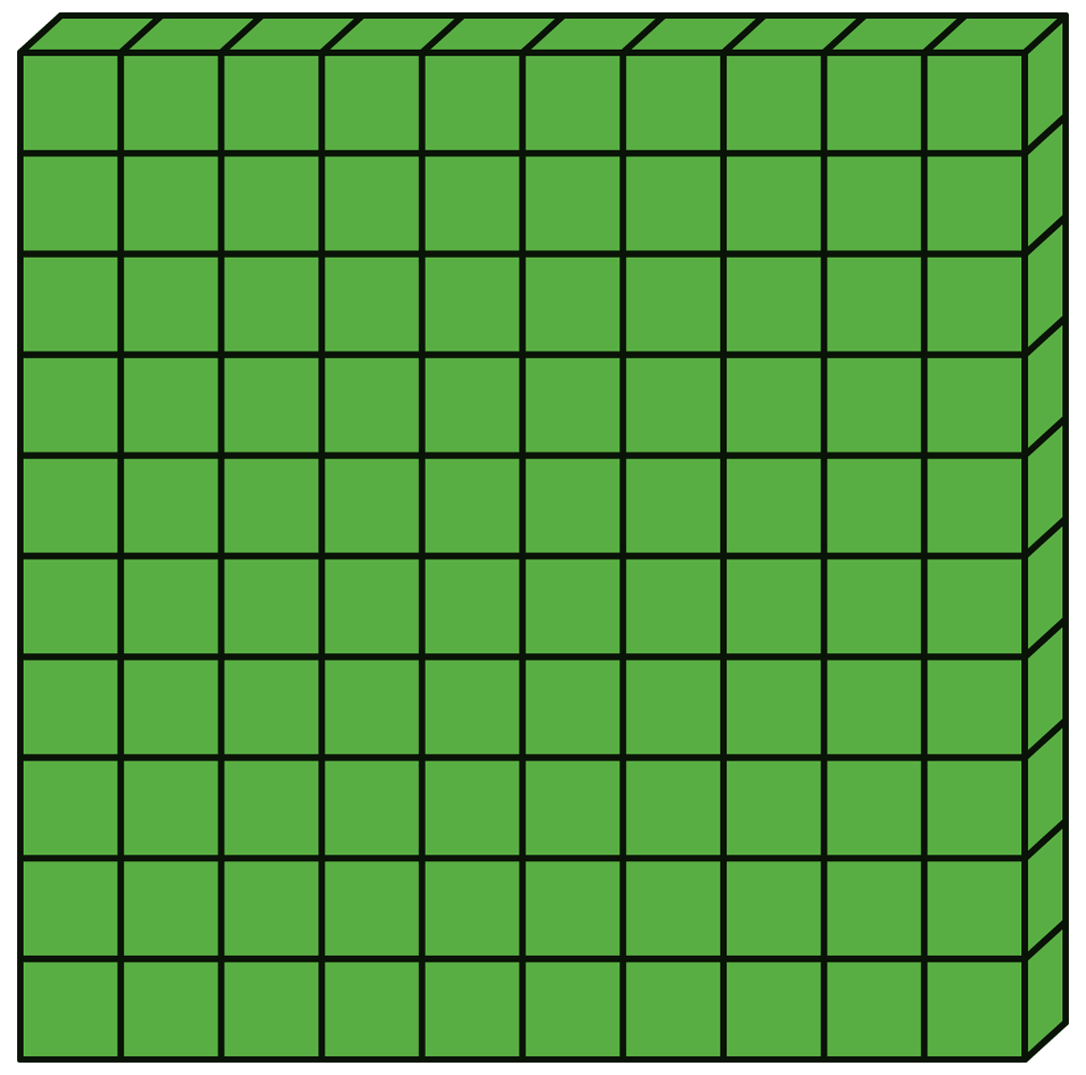
To compare numbers, start with the digit that has the greatest place value.
214
125
Compare the hundreds first.
200 is greater than 100.
>
So 214
125

Slide 3
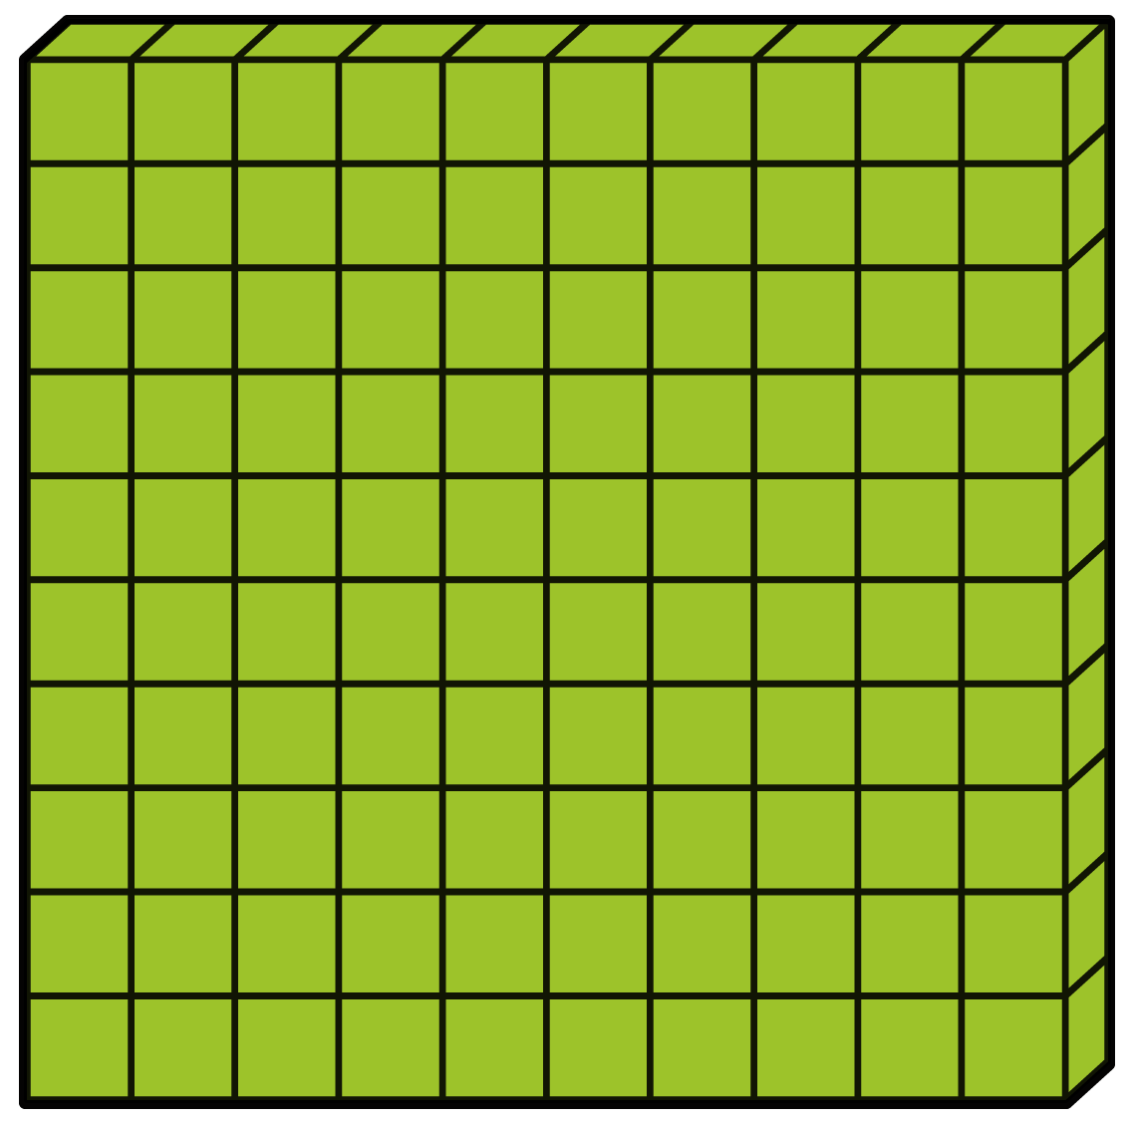
If the hundreds are equal, compare the tens.
258
262
50 is less than 60.
<
So 258
262

Slide 4
If the hundreds and Tens are equal, compare the Ones.
148
142
8 is greater than 2.
>
So 148
142

Slide 5
Let’s practice!
Compare 437 and 597.
Compare 482 and 439.
437
<
597
>
482
439
437 has 4 hundreds and 597 has 5 hundreds. Since 4 is less than 5, 437 is less than 597.
482 and 439 both have 4 hundreds so you need to compare the tens. 482 has 8 tens and 439 has 3 tens. Since 8 is greater than 3, 482 is greater than 439.

Slide 6
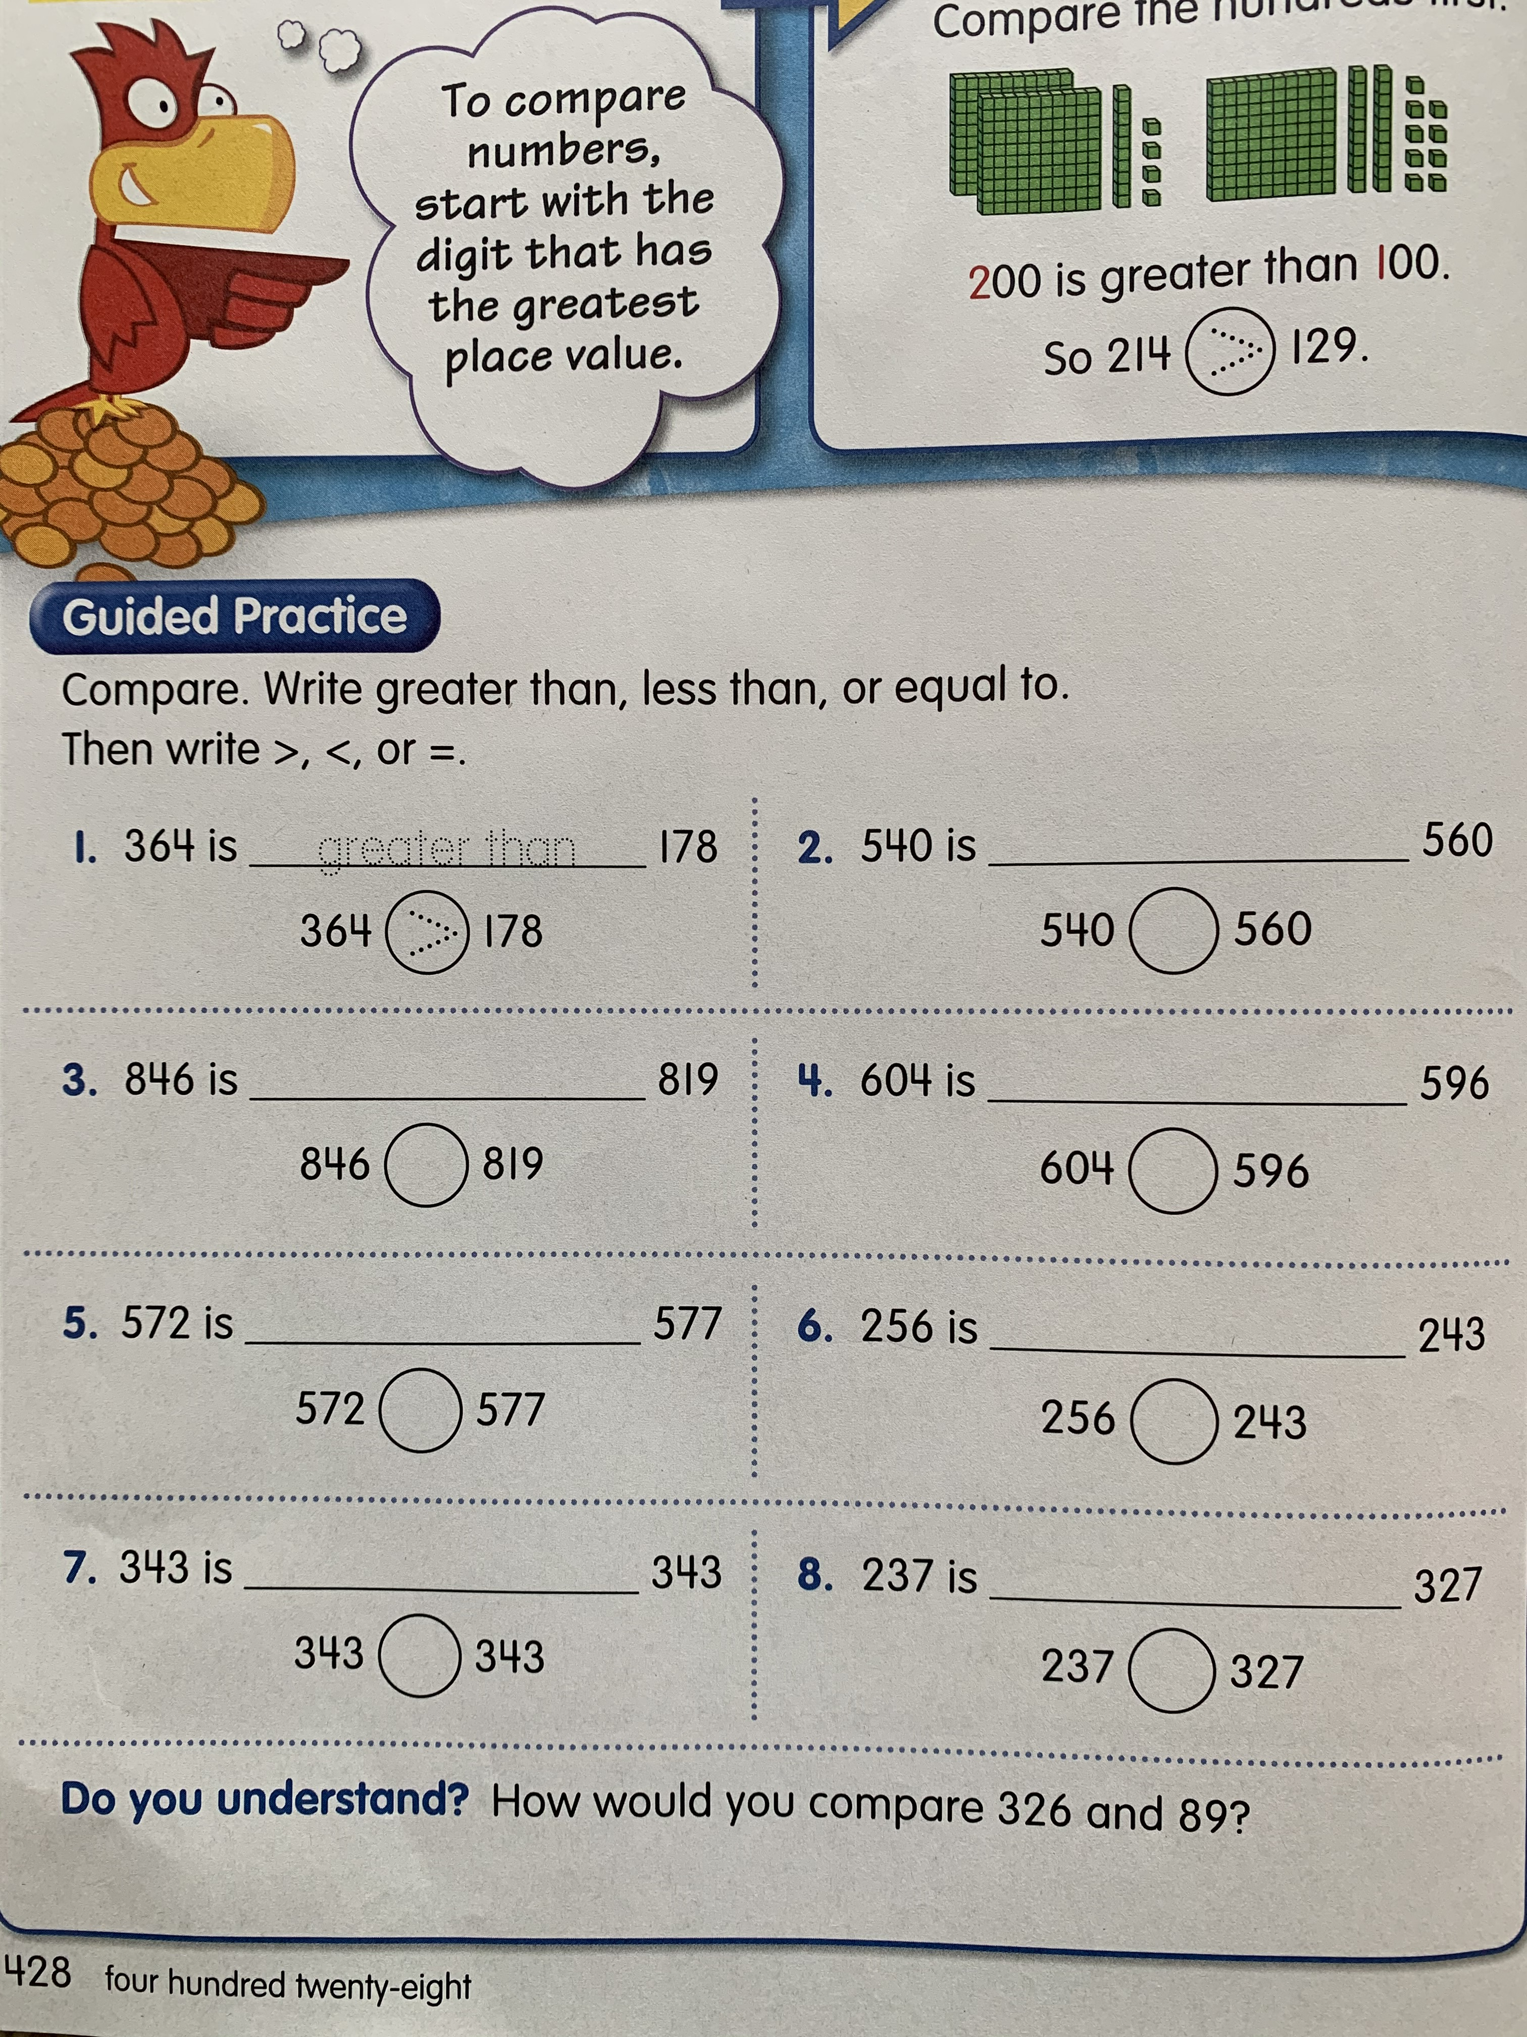
Answer these questions on a separate sheet of paper.

Slide 7
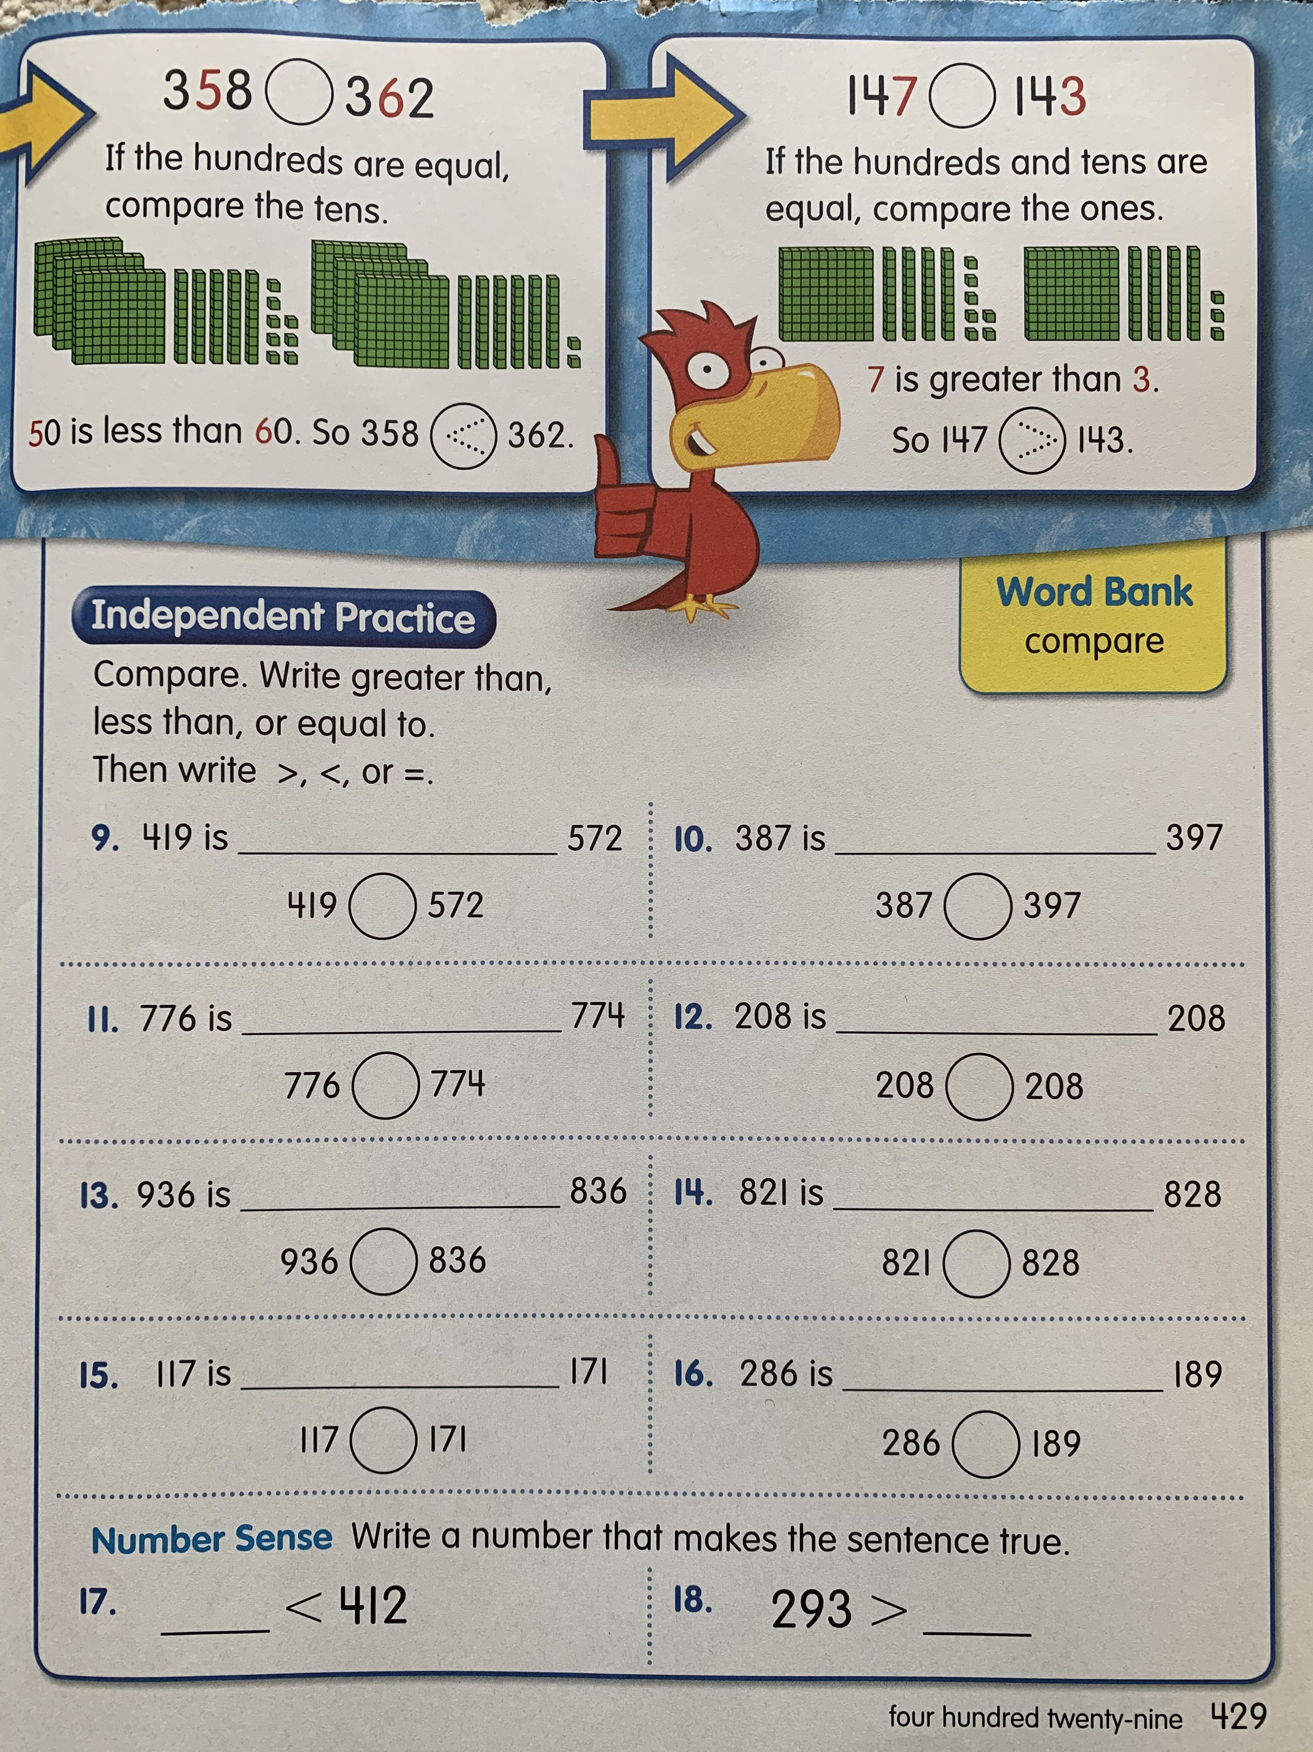

Slide 8
