Slide 1
15-3 Patterns with Numbers on Hundreds Charts

Slide 2
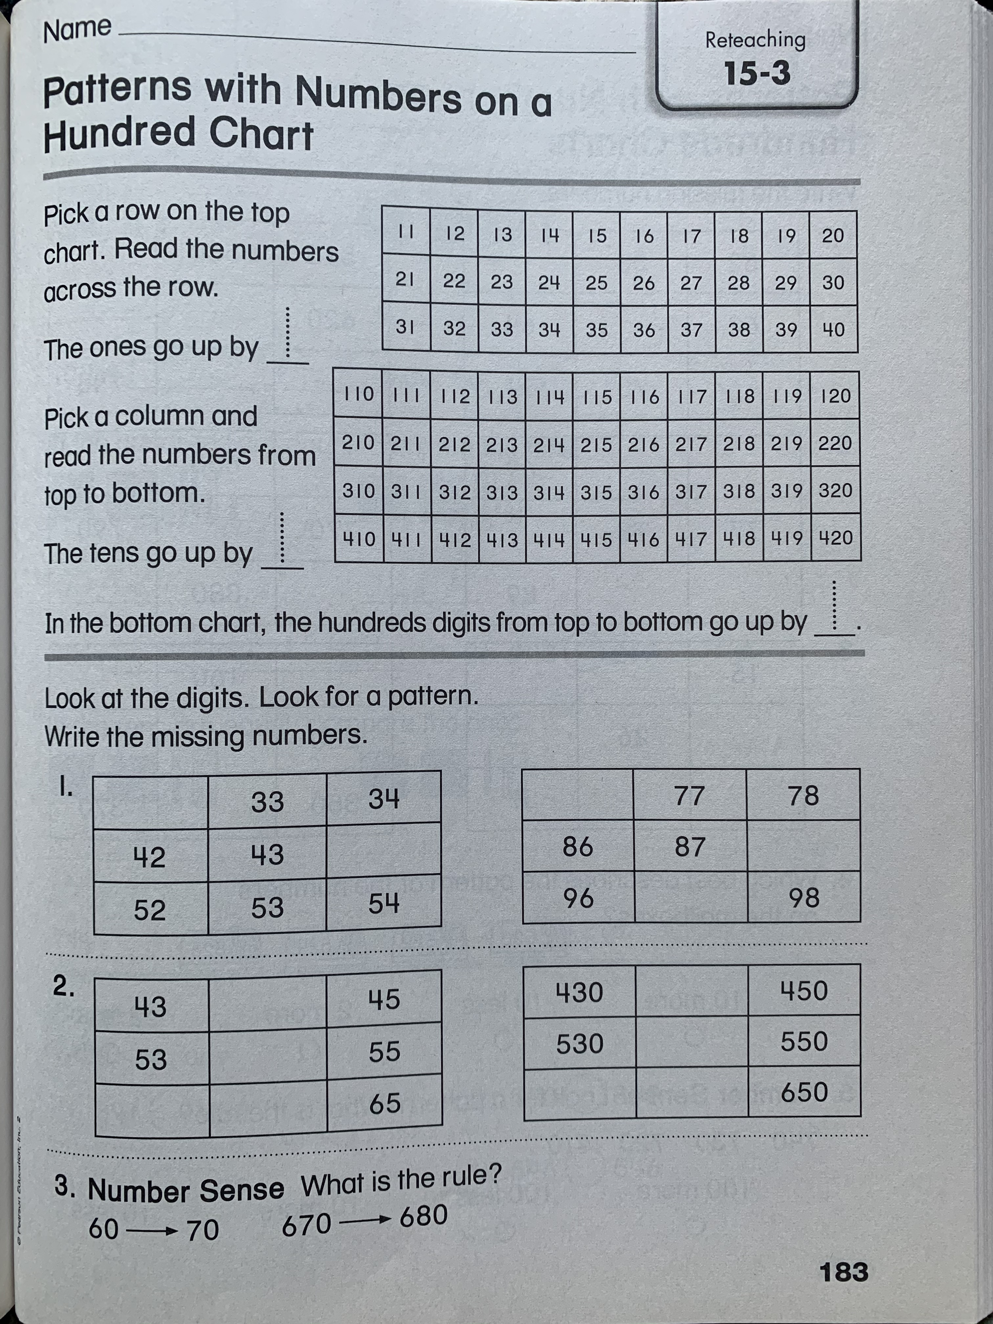
Please read the examples.

Slide 3
Solve these problems on a separate sheet of paper.
Try your best to draw the boxes. It doesn’t have to look perfect!

Slide 4
