Slide 1
15-3 Patterns with Numbers on Hundreds Charts

Slide 2
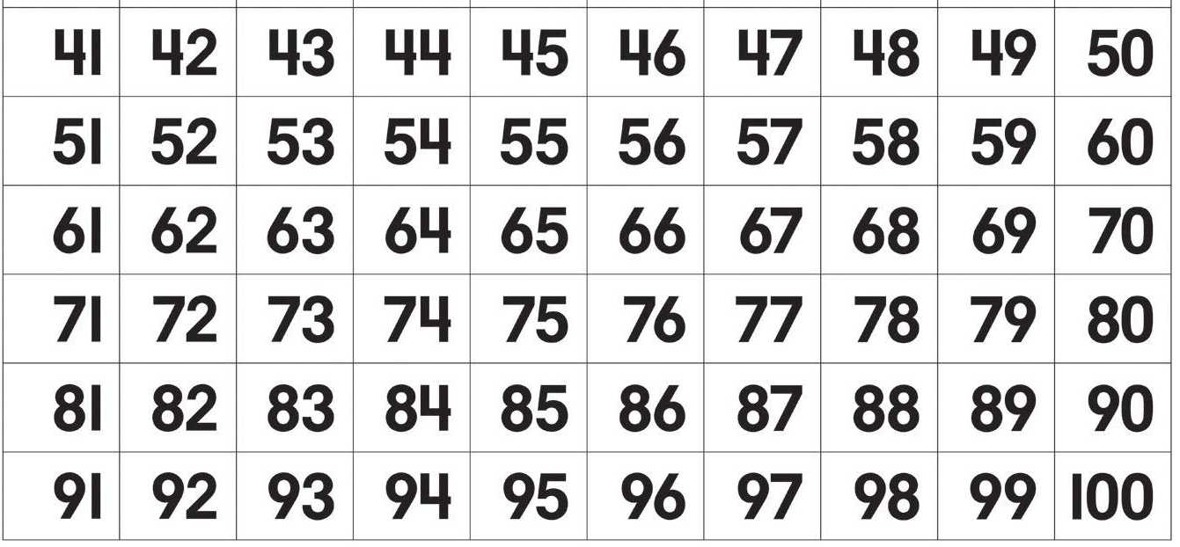
What pattern is shown by the ones digit from left to right?

Slide 3
What pattern is shown by the ones digit from left to right?
The ones digit in each row go up by 1.

Slide 4
What pattern is shown by the tens digit from top to bottom?

Slide 5
What pattern is shown by the tens digit from top to bottom?
The tens digits go up by 1.

Slide 6
There are similar patterns in a thousands chart counting by tens

Slide 7
What pattern do you notice going left to right?

Slide 8
What pattern do you notice going left to right?
The tens digit goes up by 1.

Slide 9
What pattern do you notice going from the top to bottom?

Slide 10
What pattern do you notice going from the top to bottom?
The hundreds digit goes up by 1.

Slide 11
Let’s Practice!
What is 10 more than 320?

Slide 12
Let’s Practice!
What is 10 more than 320?
330

Slide 13
Let’s Practice!
What is 30 more than 320?

Slide 14
Let’s Practice!
What is 30 more than 320?
350

Slide 15
Let’s Practice!
What is 200 more than 320?

Slide 16
Let’s Practice!
What is 200 more than 320?
520

Slide 17
Let’s Practice!
What is 20 less than 540?

Slide 18
Let’s Practice!
What is 20 less than 540?
520

Slide 19
Let’s Practice!
What is 300 less than 540?

Slide 20
Let’s Practice!
What is 300 less than 540?
240

Slide 21
You can use this chart as a resource to help you with your assignment.

Slide 22
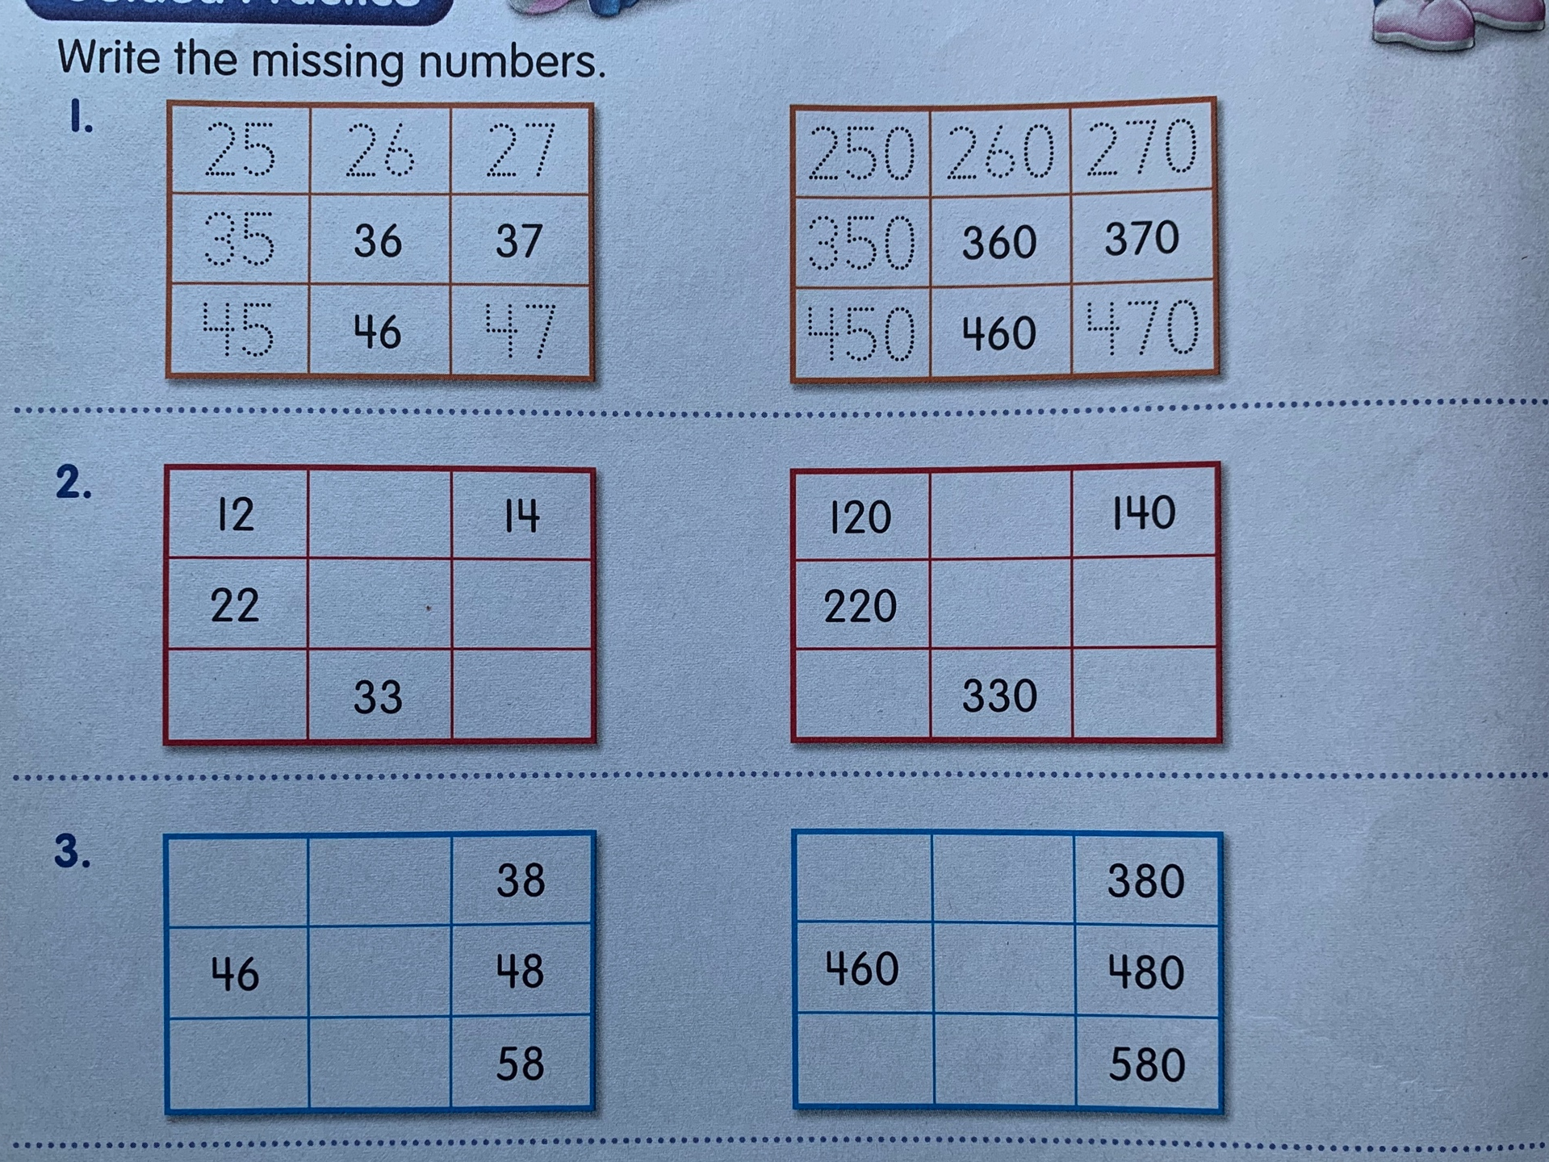
Solve these problems on a separate sheet of paper. Try your best to draw the boxes.
It doesn’t have to look perfect!

Slide 23
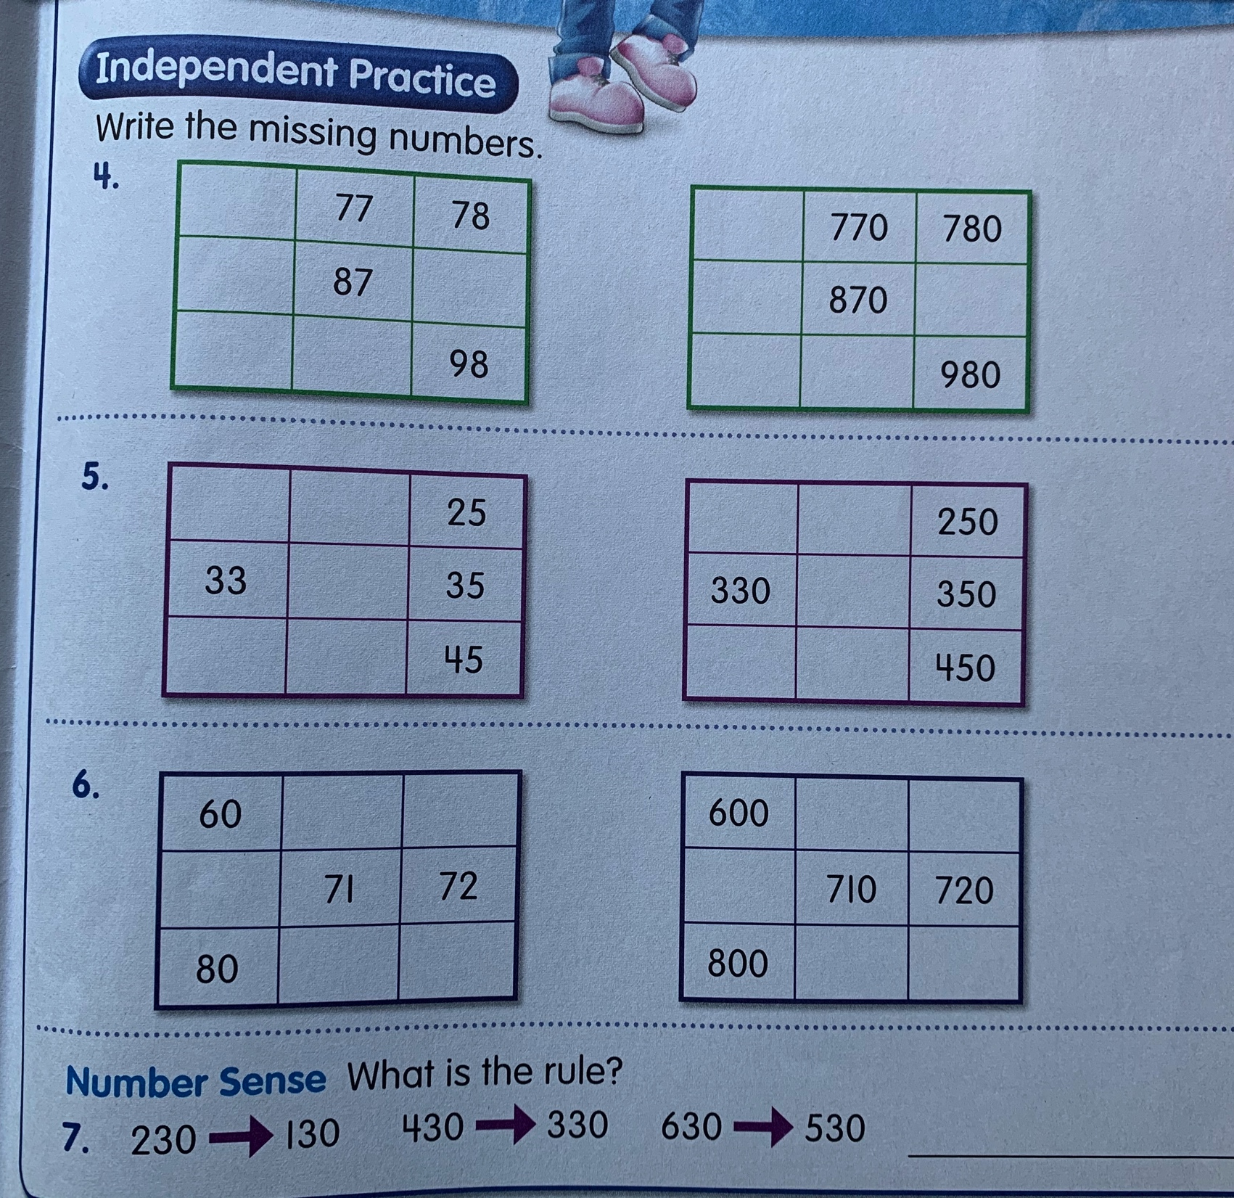

Slide 24
