Slide 1
15-2 Changing Numbers by Hundreds and Tens

Slide 2
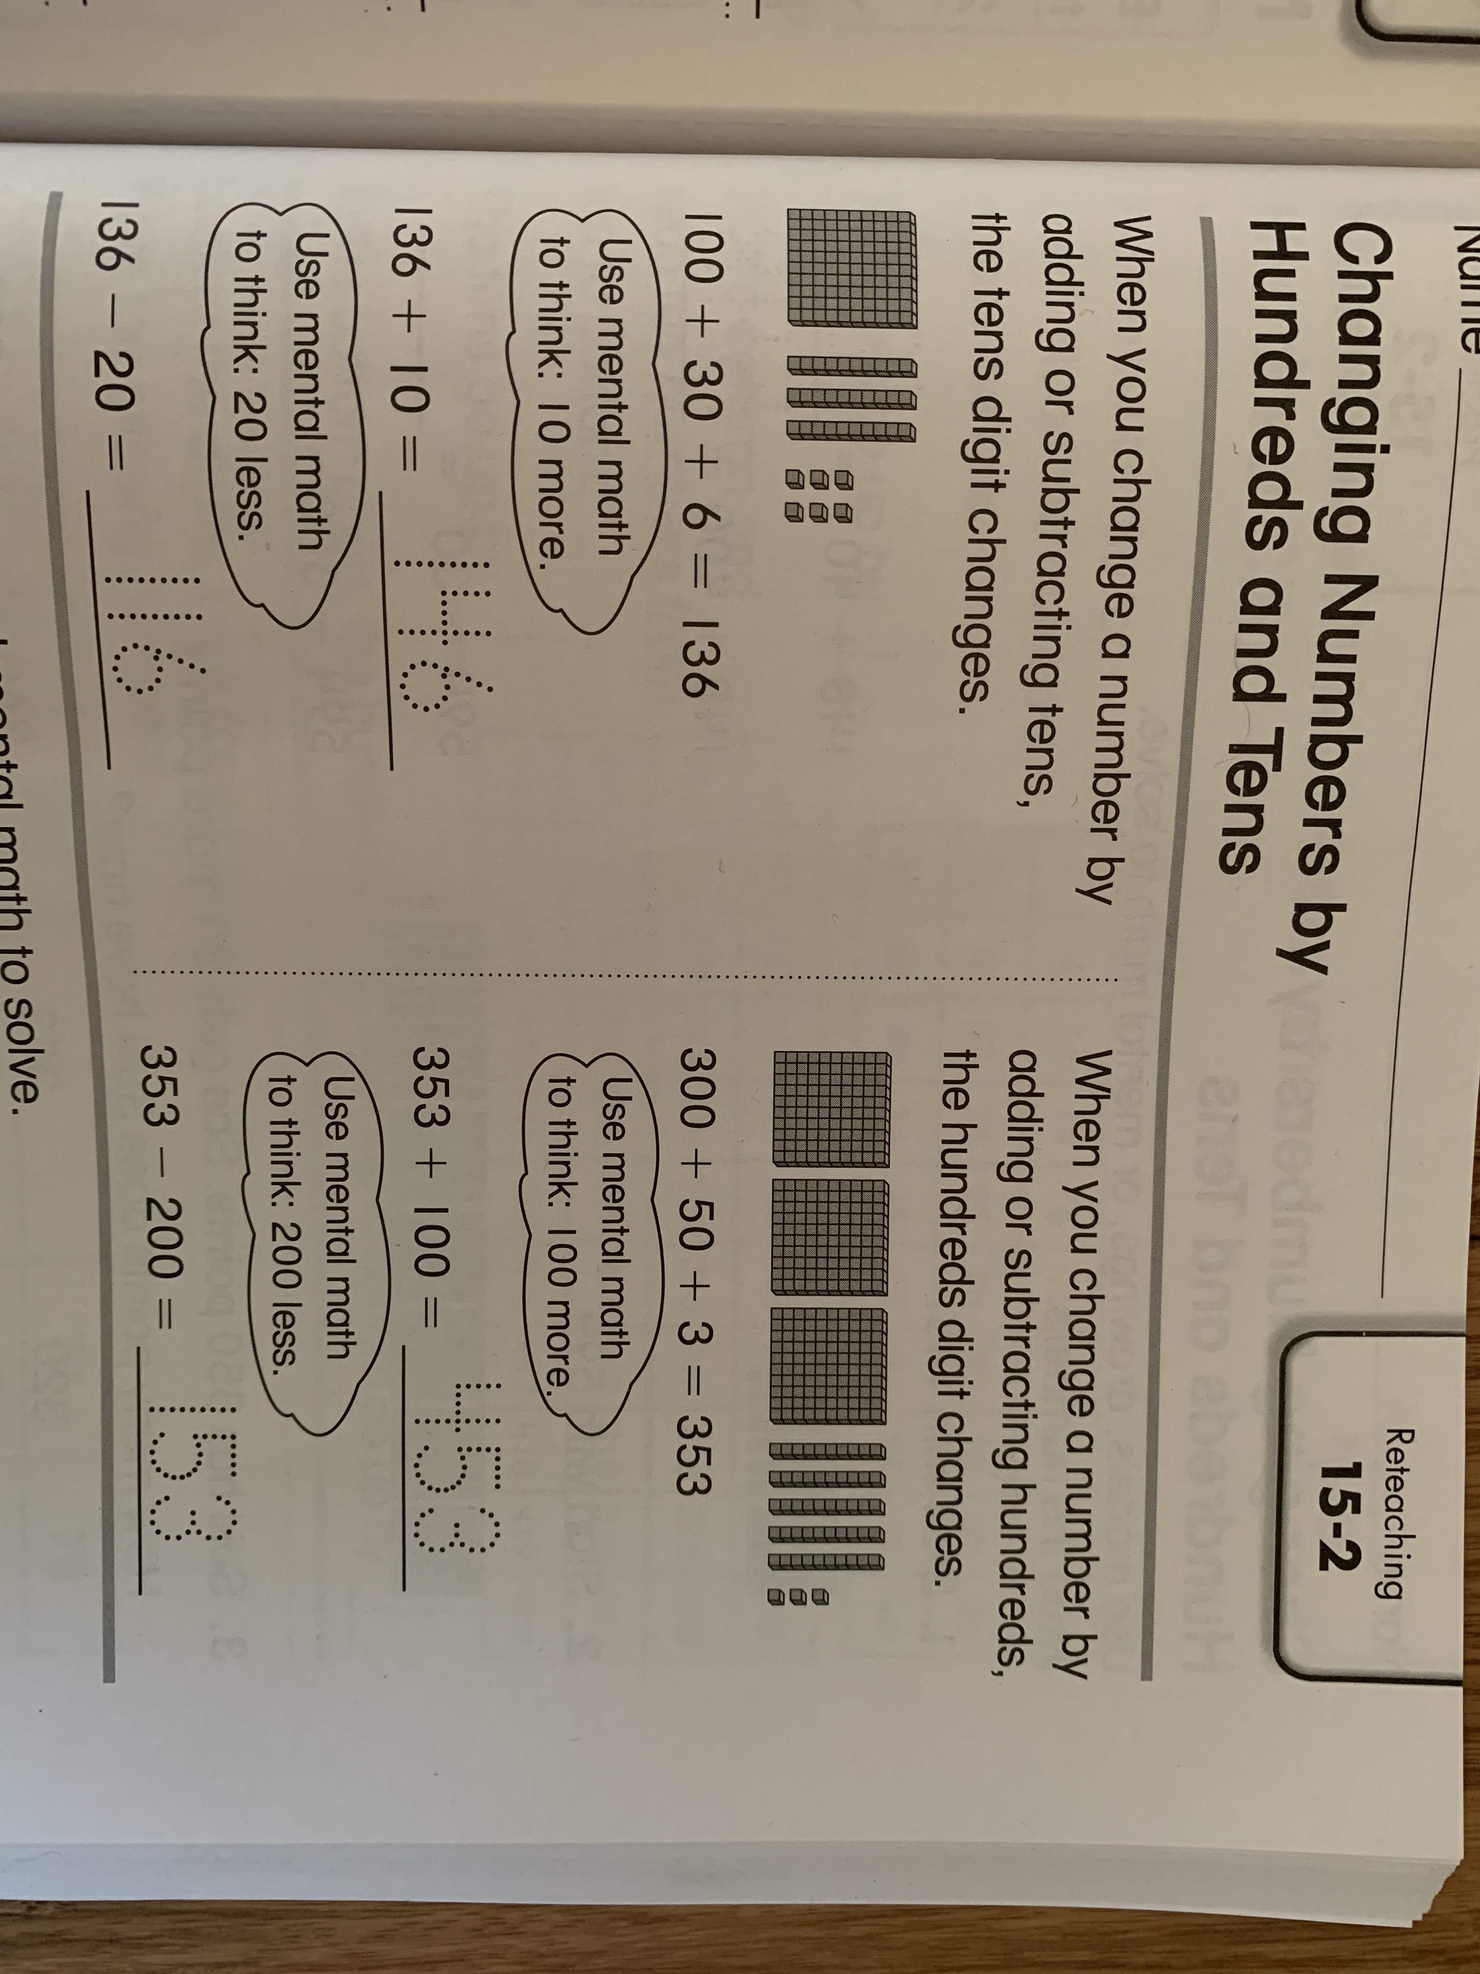
Please read the examples.

Slide 3
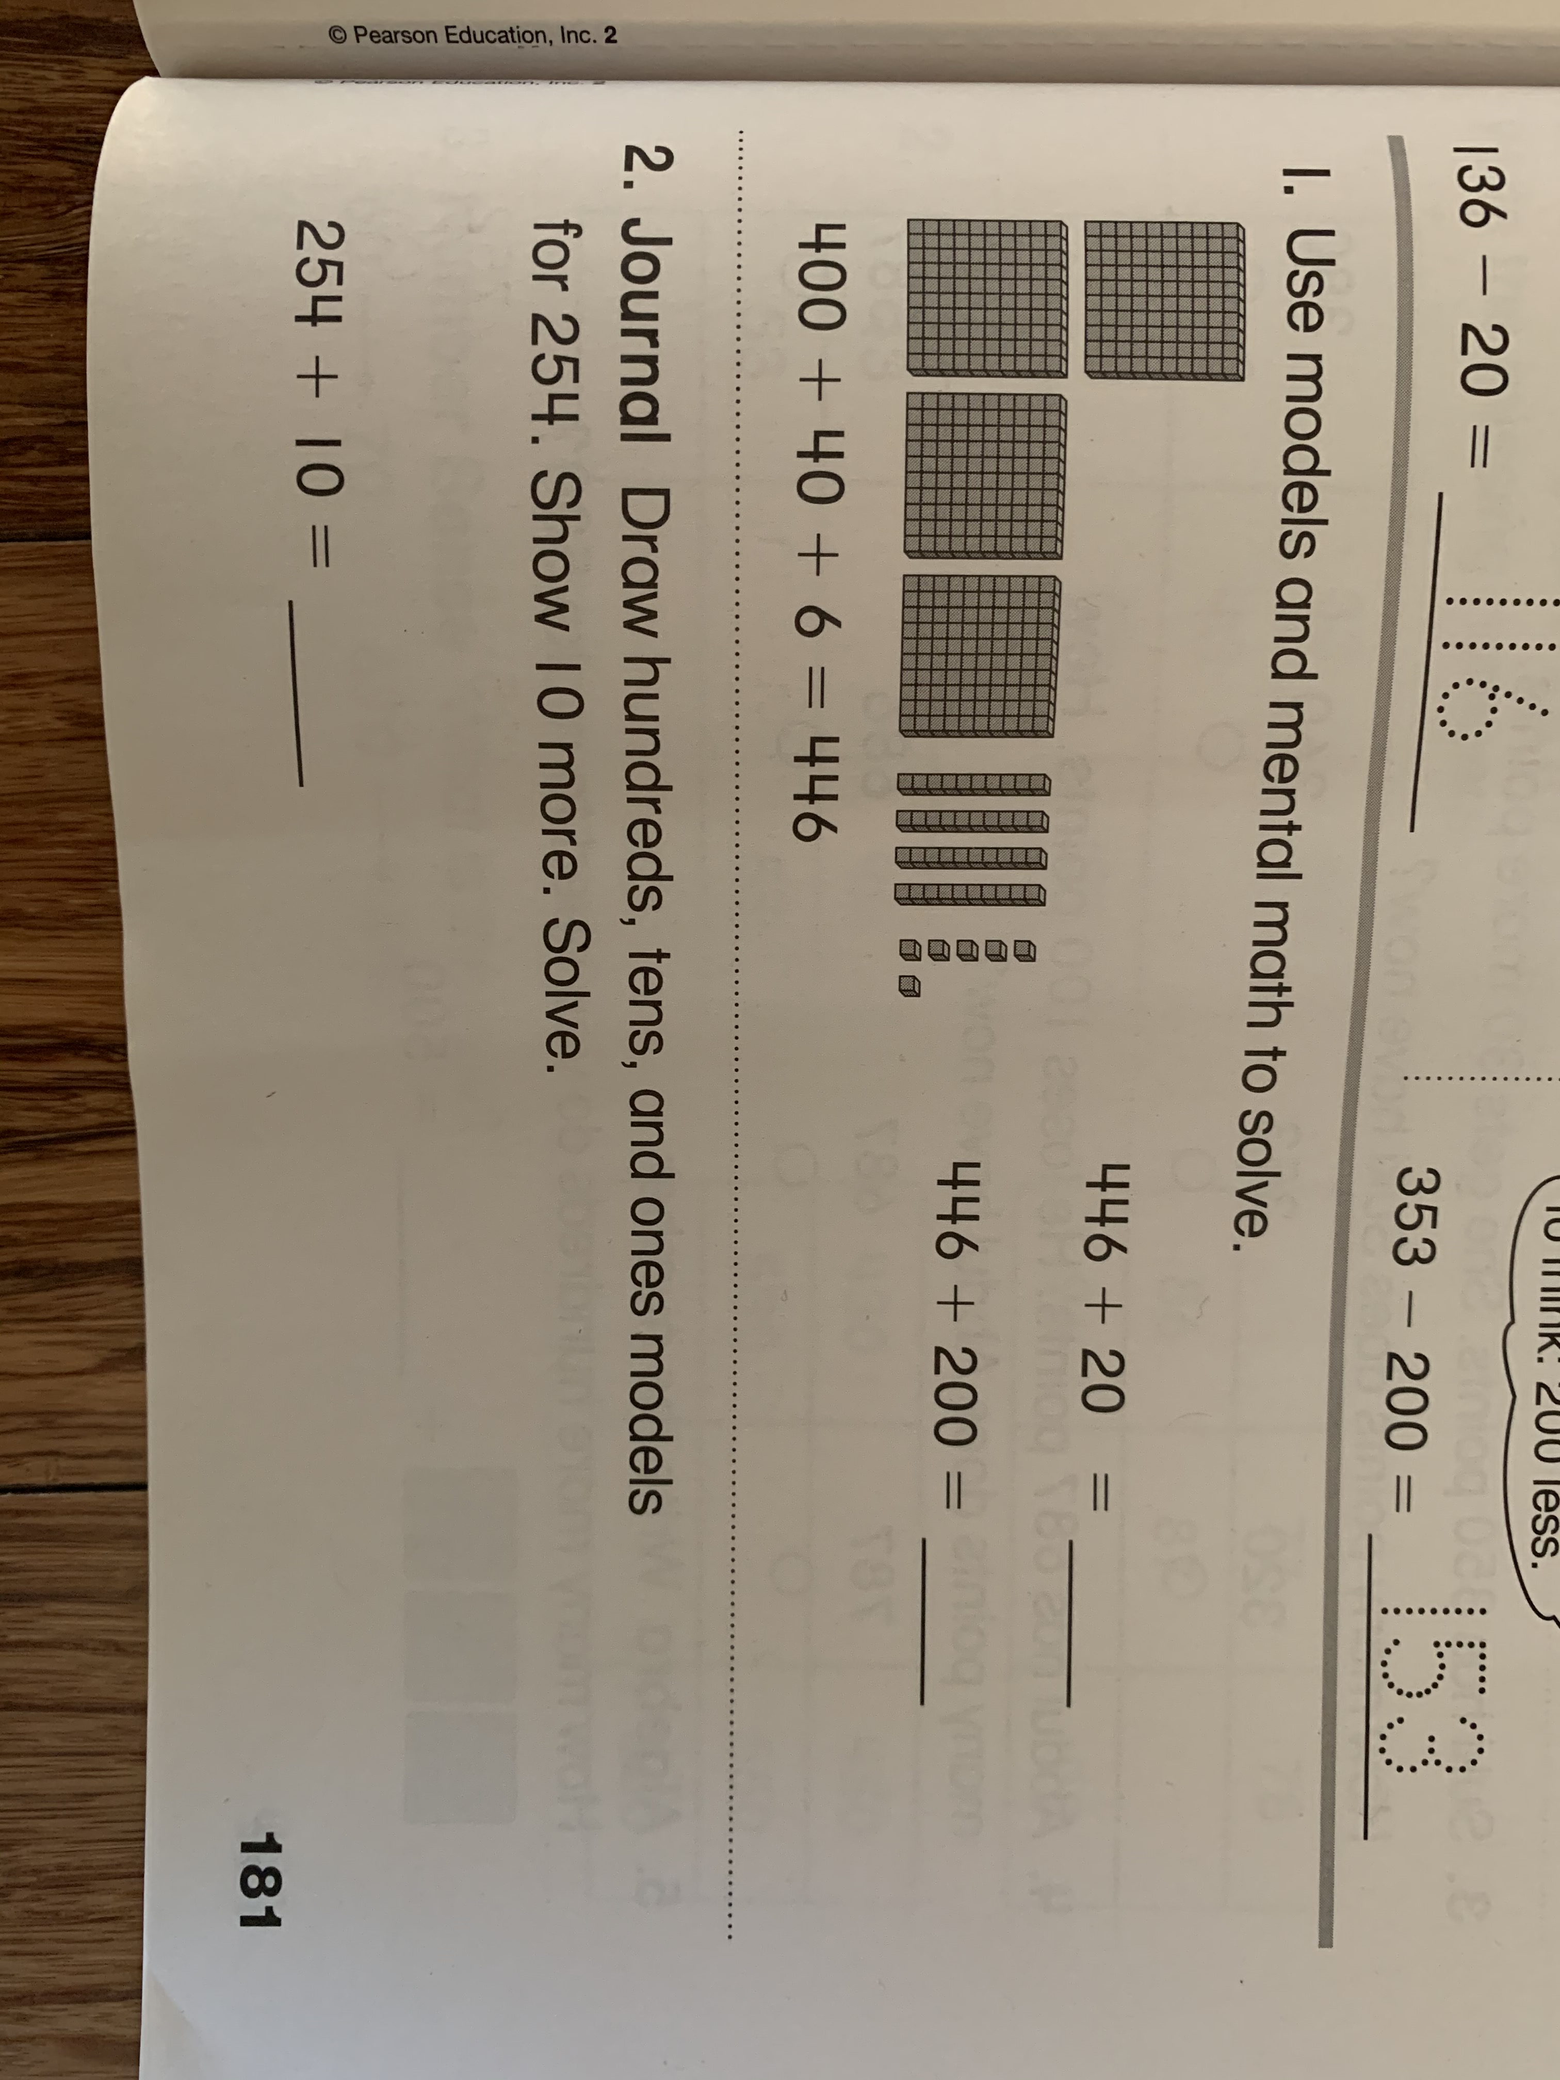
Solve the following problems on a separate sheet of paper.

Slide 4
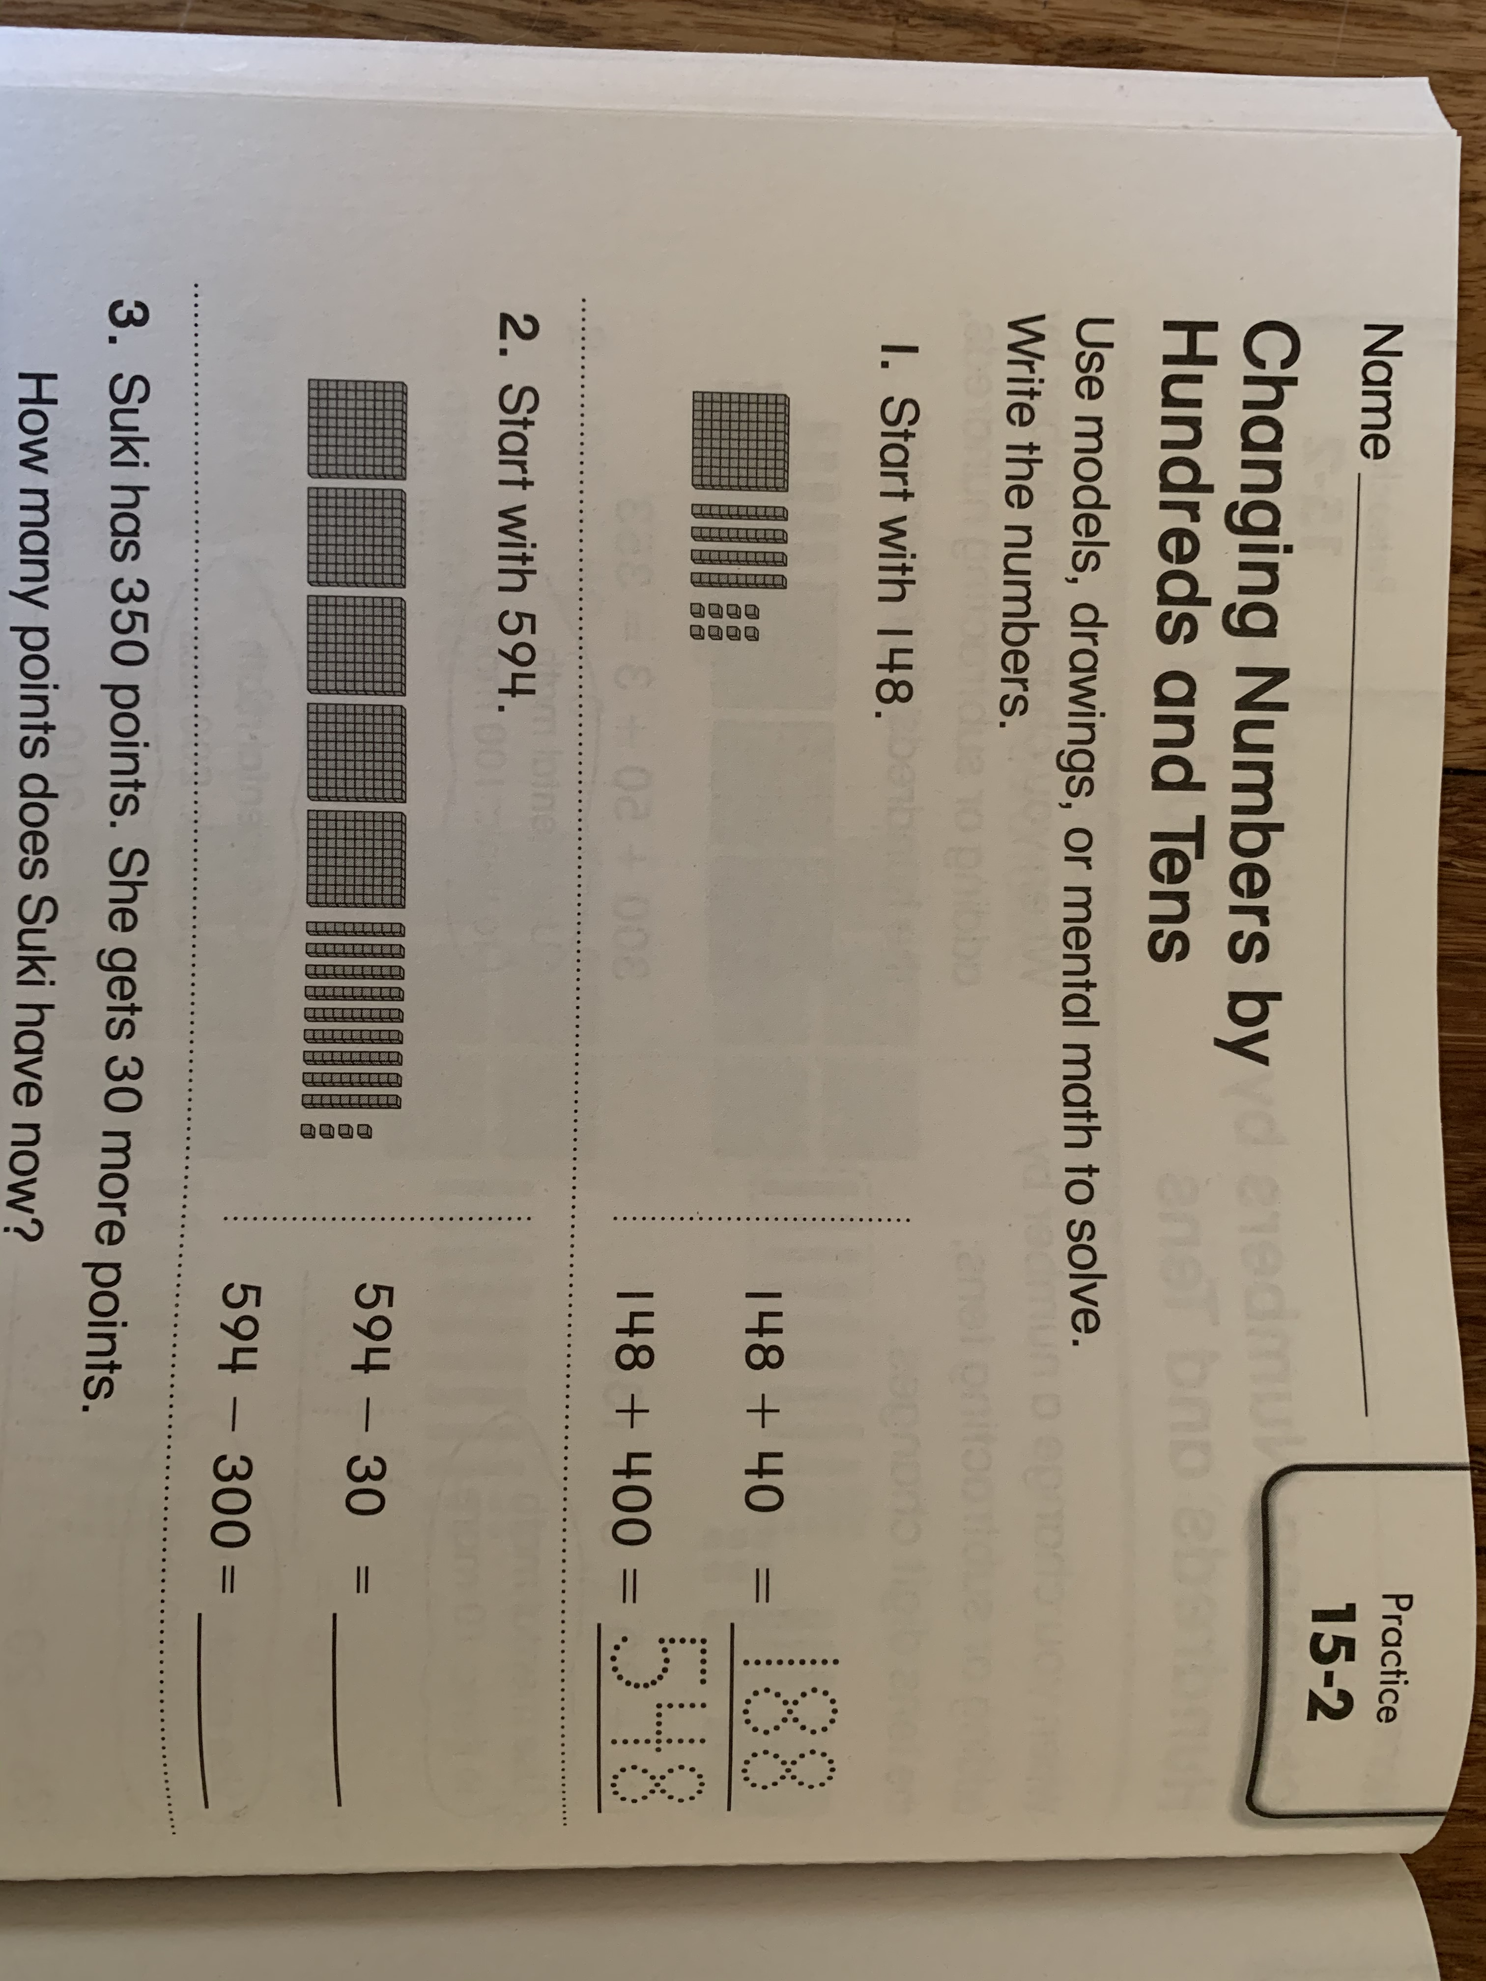

Slide 5
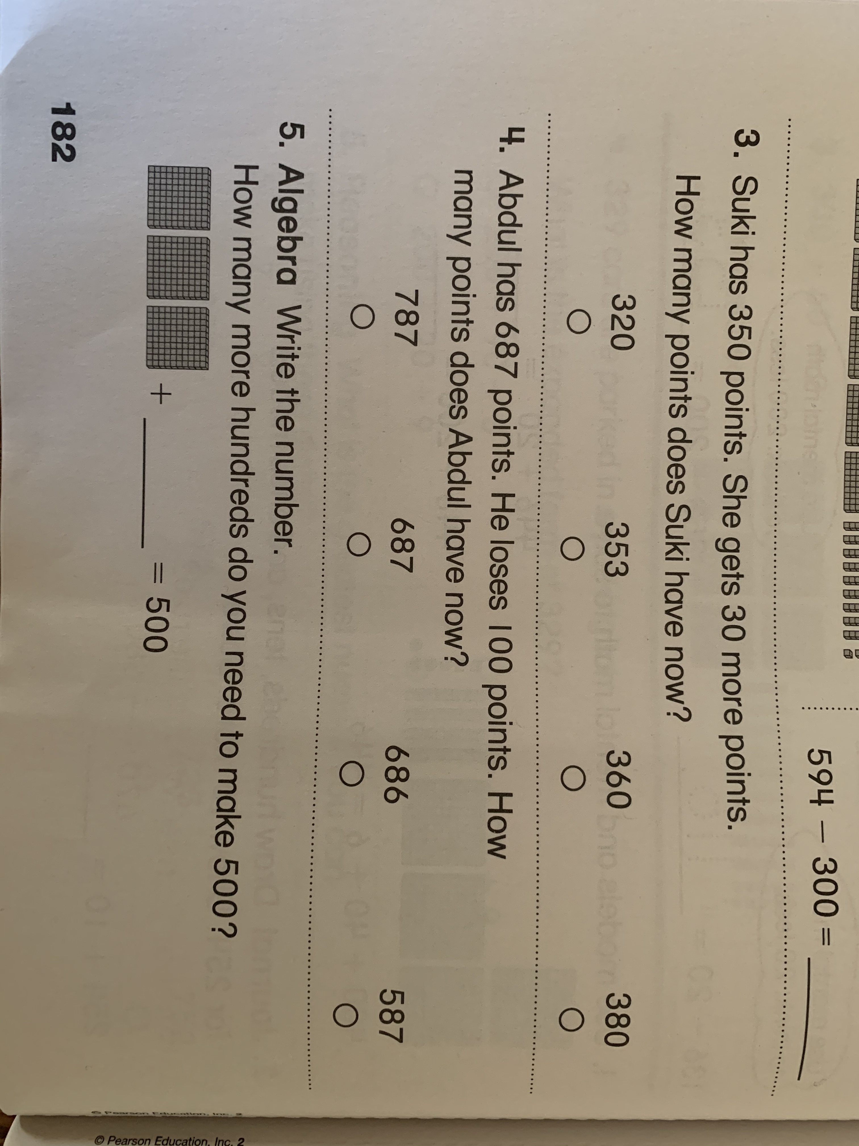

Slide 6
Please work on the next assignment on your own.
Label your paper 15-2 Quick Check.

Slide 7
