Slide 1
15-2 Changing Numbers by Hundreds and Tens

Slide 2
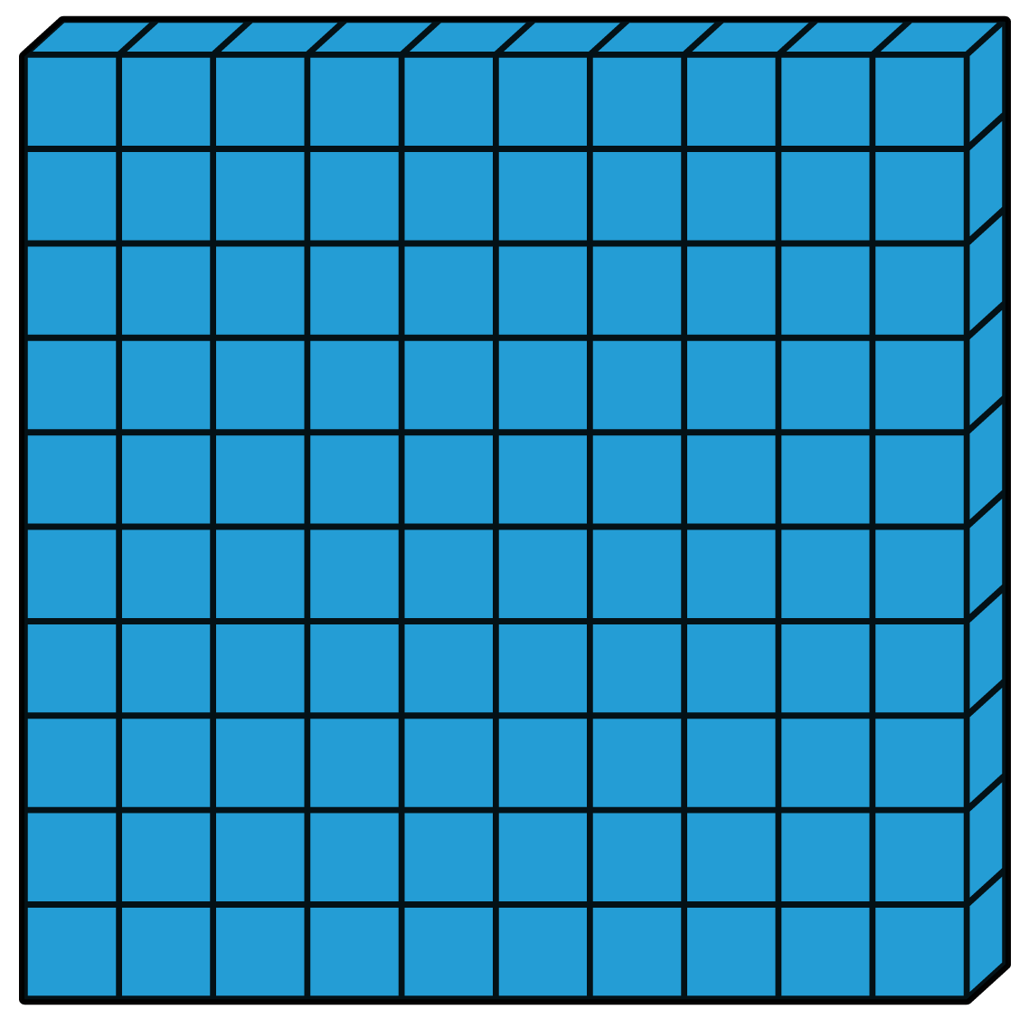
The model shows the number 238.
200 + 30 +8 = 238

Slide 3
When You change a number by adding tens, the tens digit changes.
238 + 10 = 248

Slide 4
When You change a number by subtracting tens, the tens digit changes.
238 – 20 = 218

Slide 5
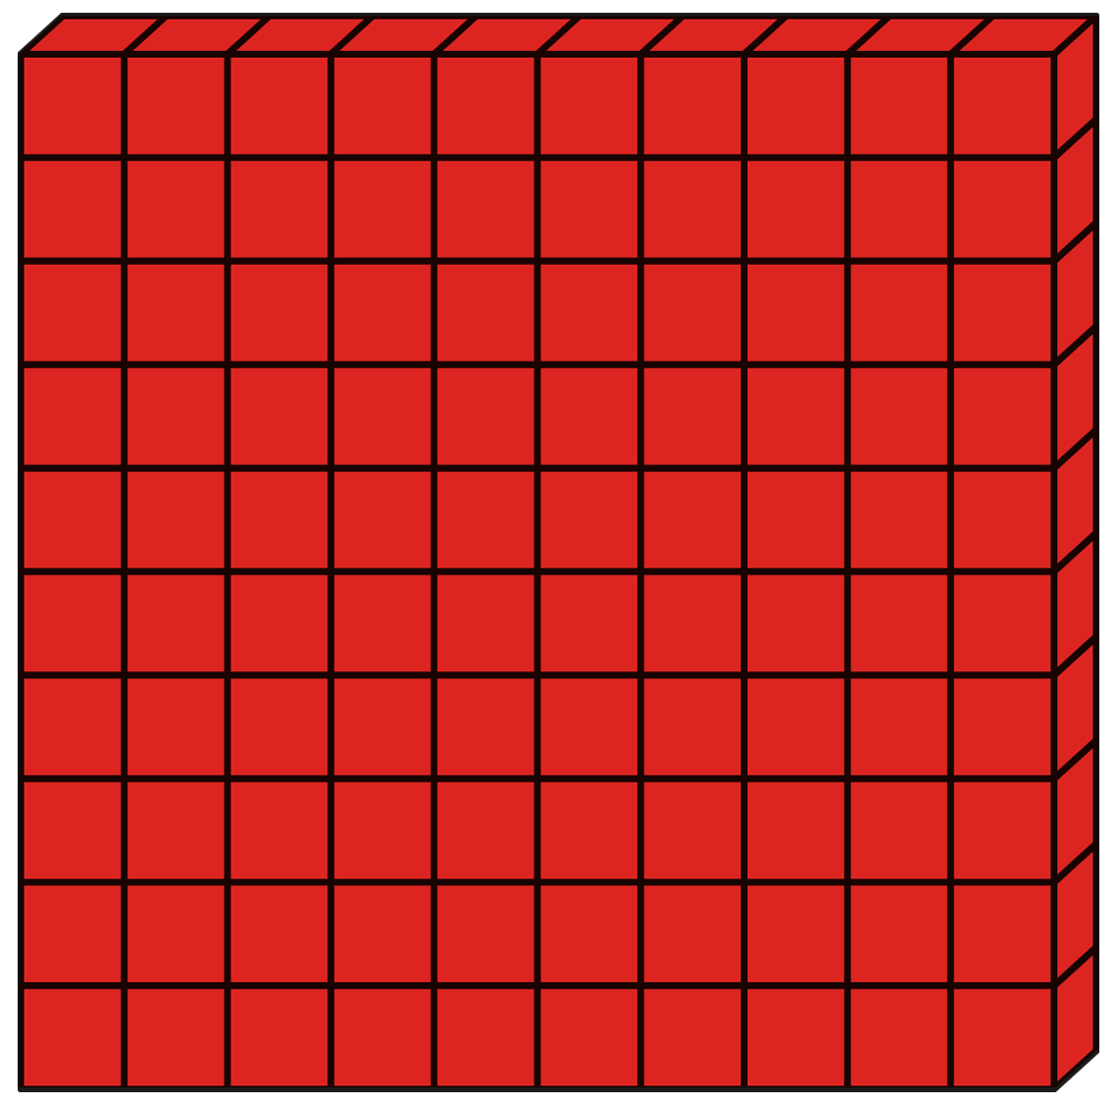
When You change a number by adding hundreds, the hundreds digit changes.
238 + 200 = 438

Slide 6
When You change a number by subtracting hundreds, the hundreds digit changes.
238 - 100 = 138

Slide 7
Let’s practice!
354 + 30 =

Slide 8
Let’s practice!
354 + 30 = 384

Slide 9
Let’s practice!
354 - 40 =

Slide 10
Let’s practice!
354 - 40 = 314

Slide 11
Let’s practice!
354 + 200 =

Slide 12
Let’s practice!
354 + 200 = 554

Slide 13
Let’s practice!
354 - 100 =

Slide 14
Let’s practice!
354 - 100 = 254

Slide 15
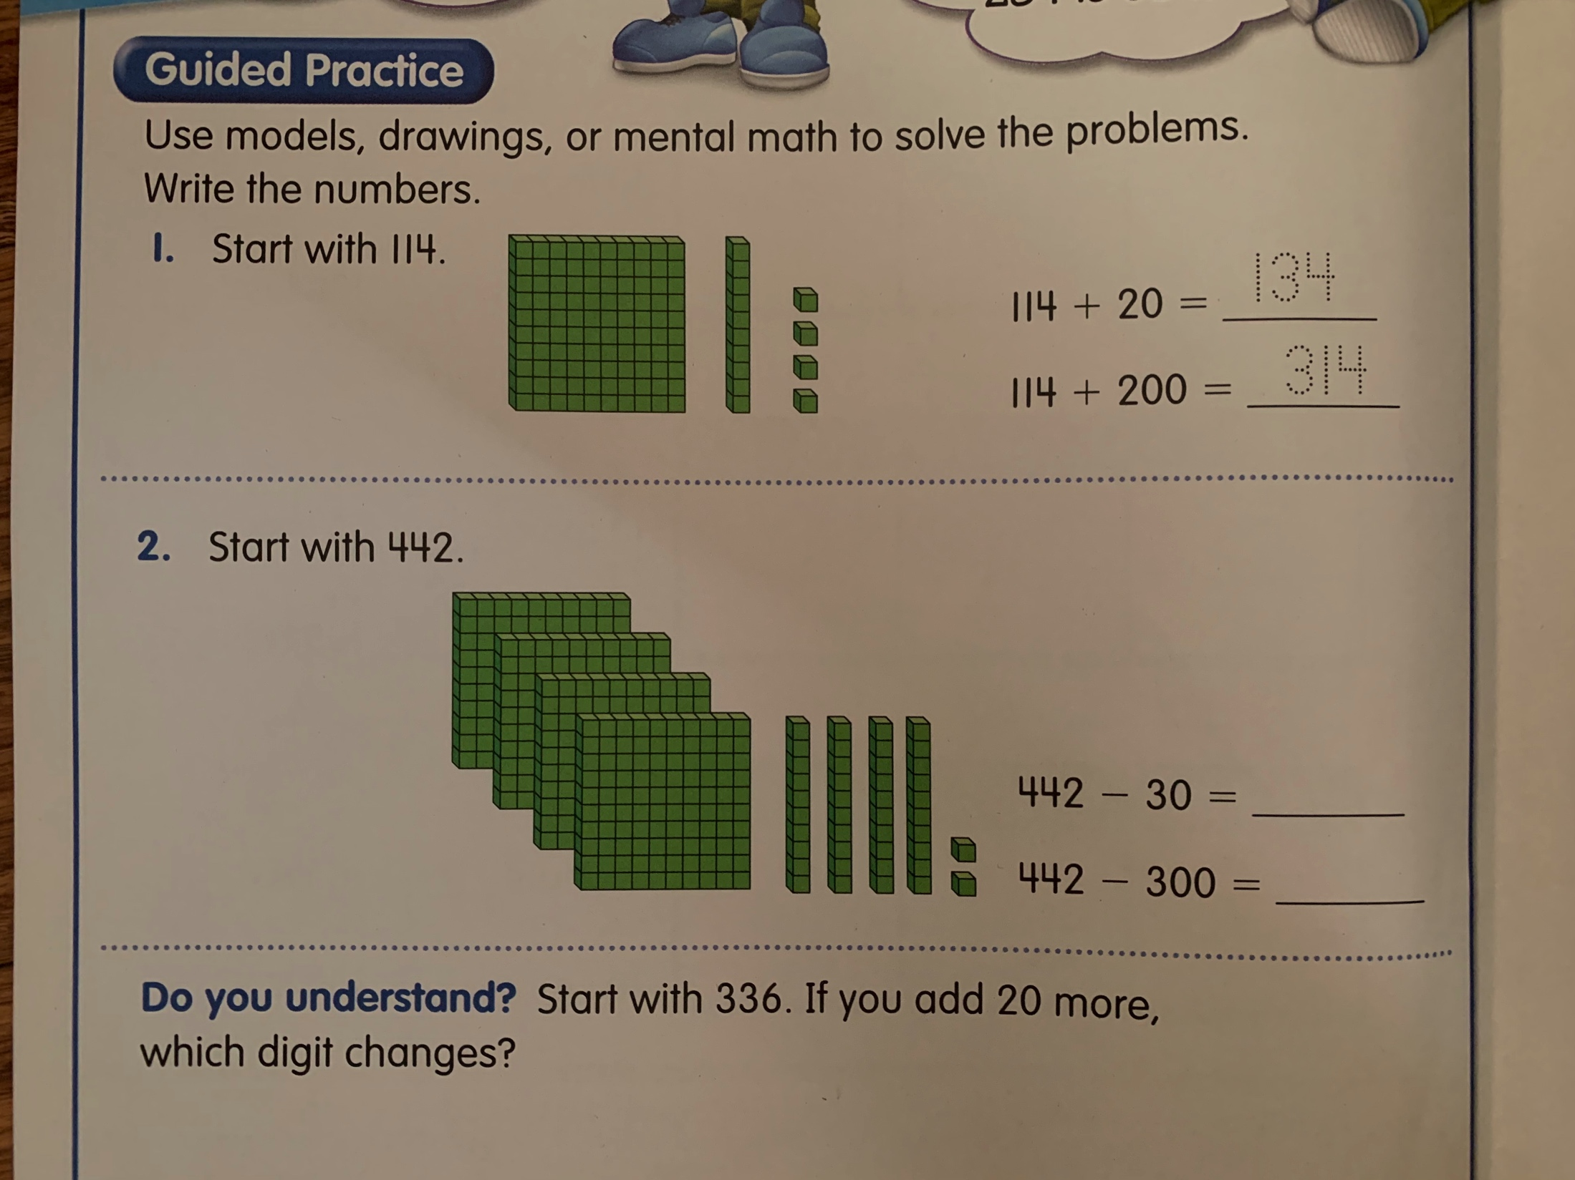
Solve these problems on a separate sheet of paper.

Slide 16
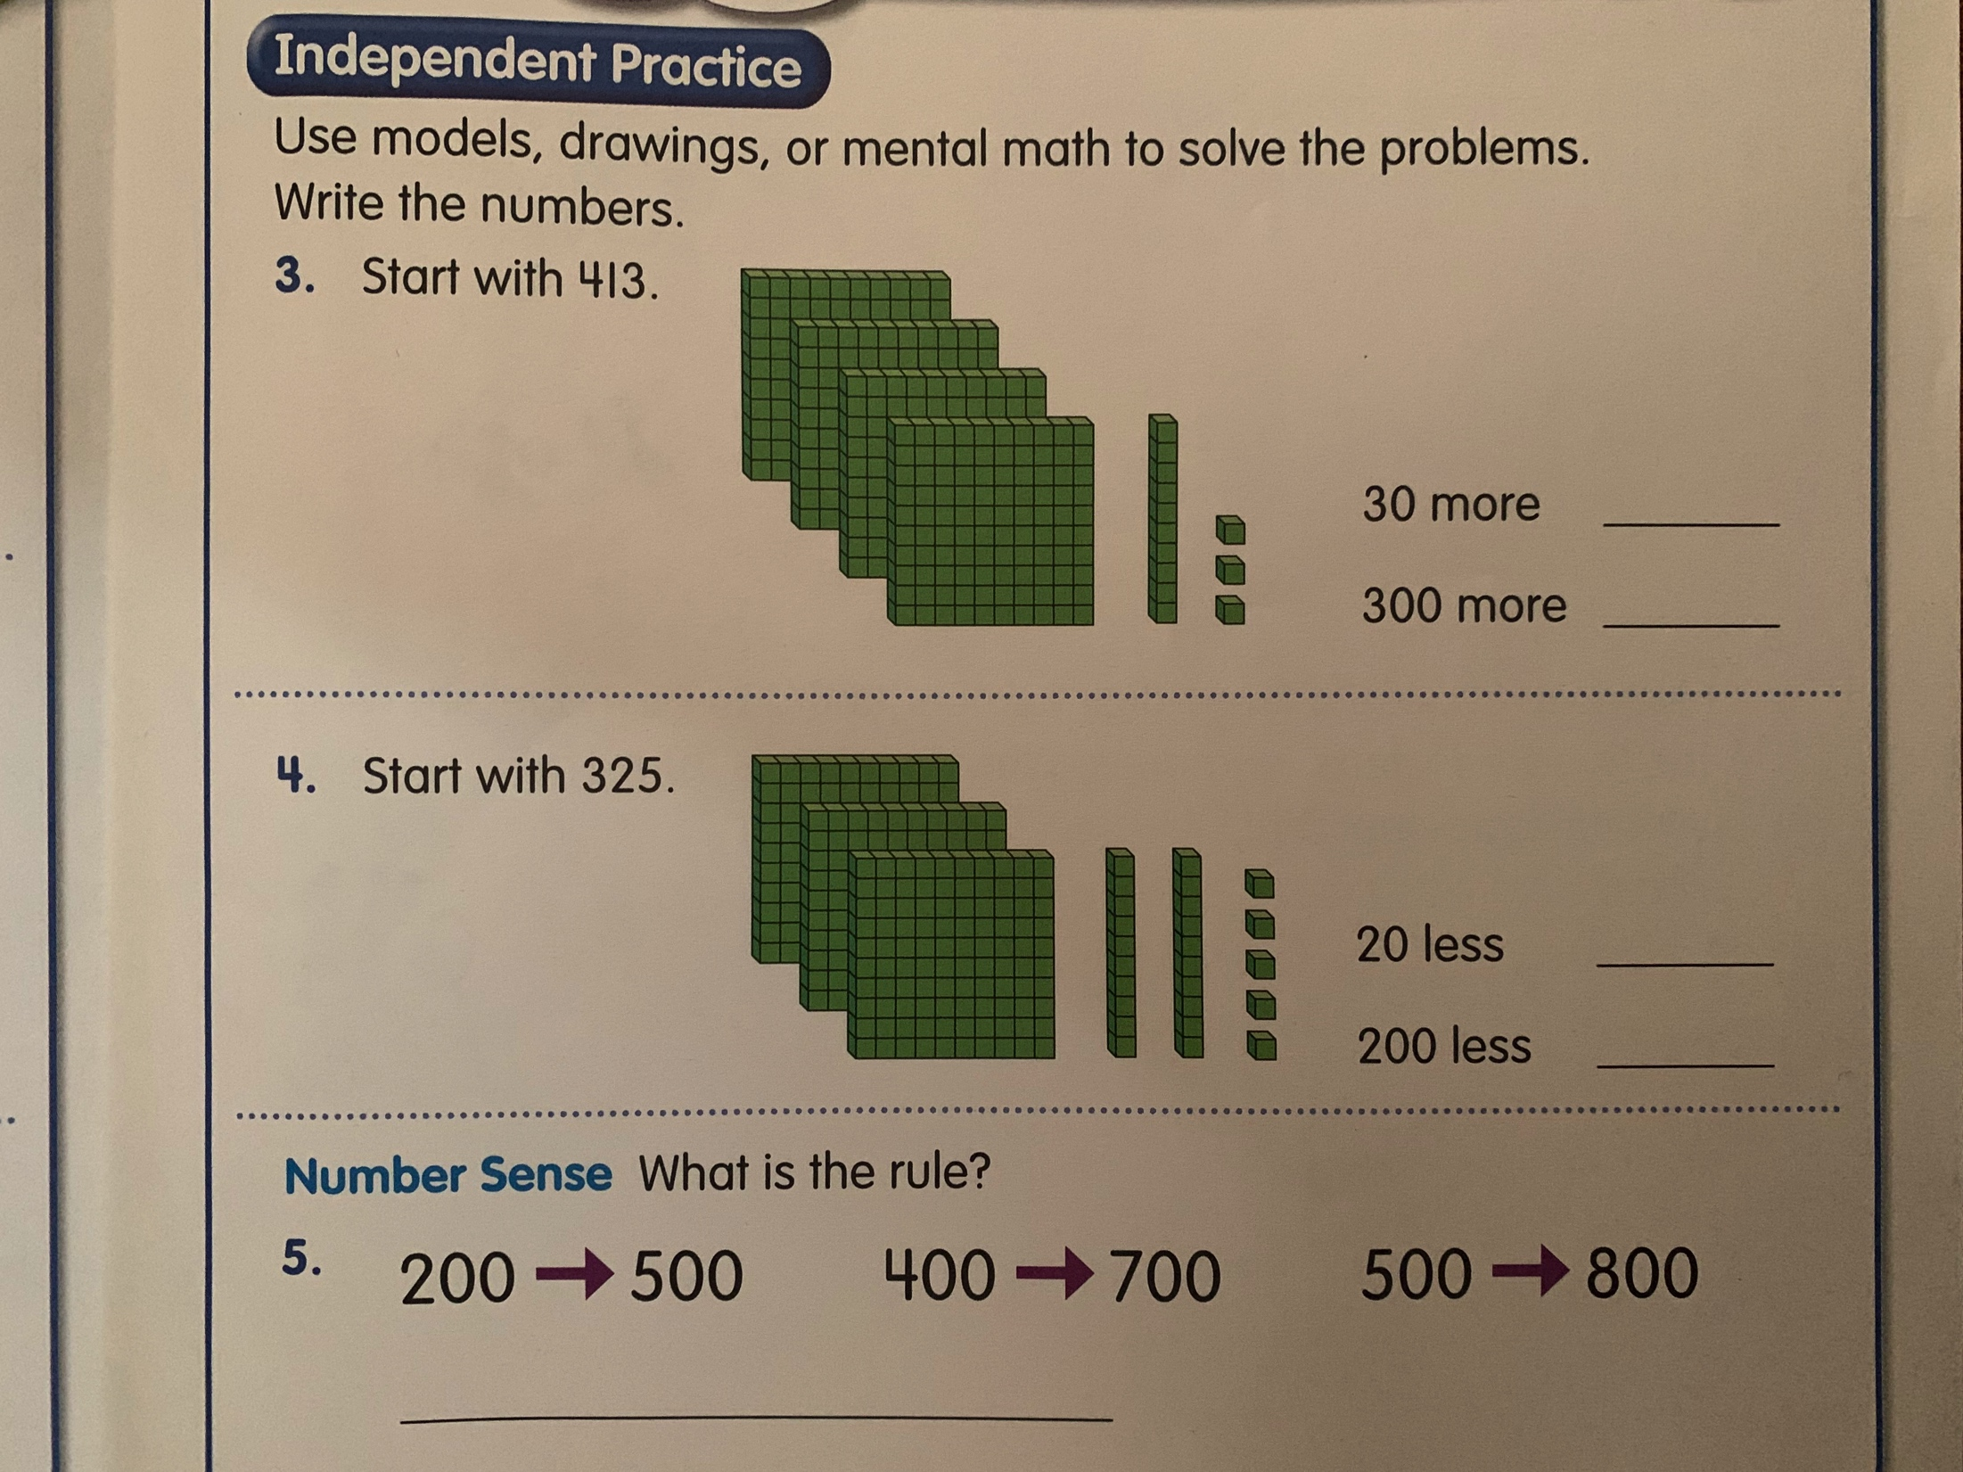

Slide 17
