Slide 1
15-1 to 15-3 Review

Slide 2
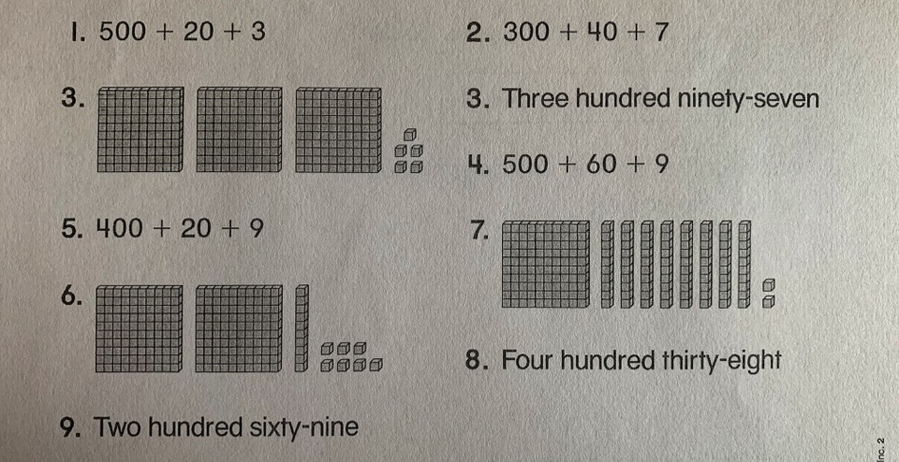
15-1 Write each number in the standard form (digits).

Slide 3
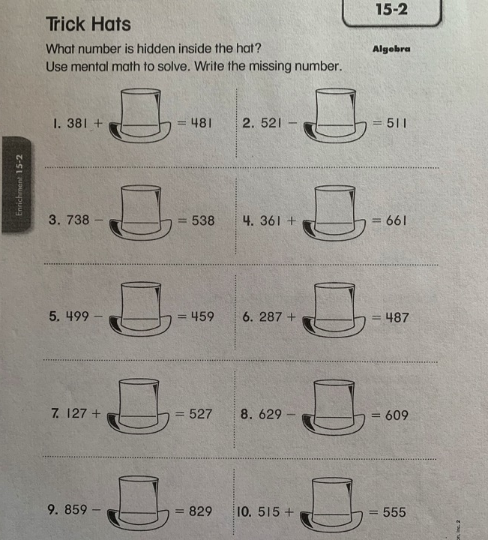
15-2

Slide 4
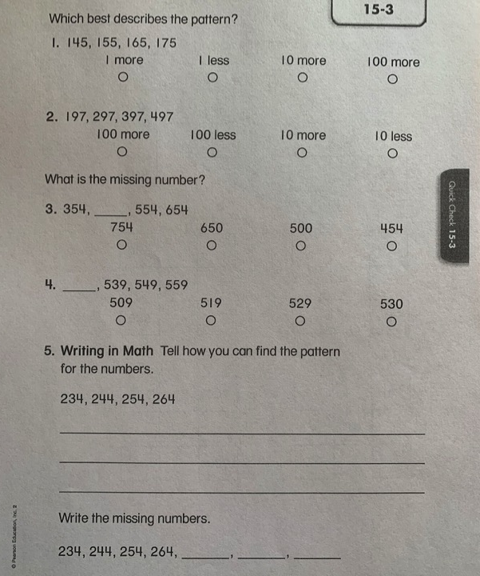
15-3
For number 5, write down the pattern and how you know this.

