Slide 1
15-1 Reading and Writing Numbers to 1,000

Slide 2
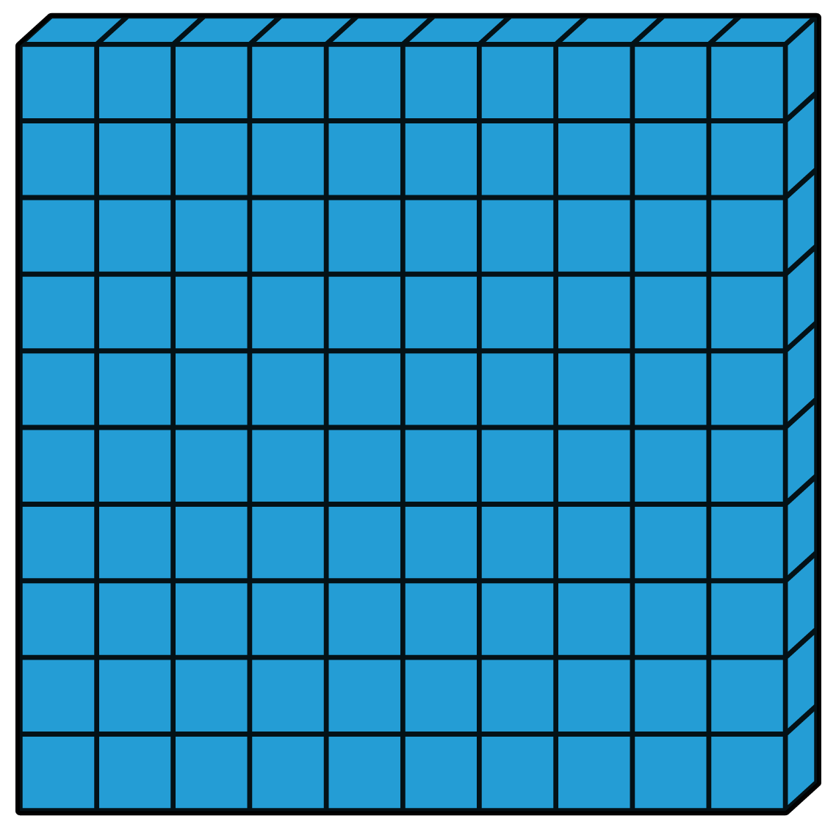
What Number is shown by the models?
Cubes = 1
Rods = 10
Flats = 100

Slide 3
You can write numbers in three different ways
Standard Form: 328
Expanded Form: 300 + 20 + 8
Word Form: three hundred twenty-eight

Slide 4
Let’s practice!
What is the standard form?

Slide 5
Let’s practice!
What is the standard form?
465

Slide 6
Let’s practice!
What is the expanded form?

Slide 7
Let’s practice!
What is the expanded form?
400 + 60 + 5

Slide 8
Let’s practice!
What is the word form?

Slide 9
Let’s practice!
What is the word form?
Four hundred sixty-five

Slide 10
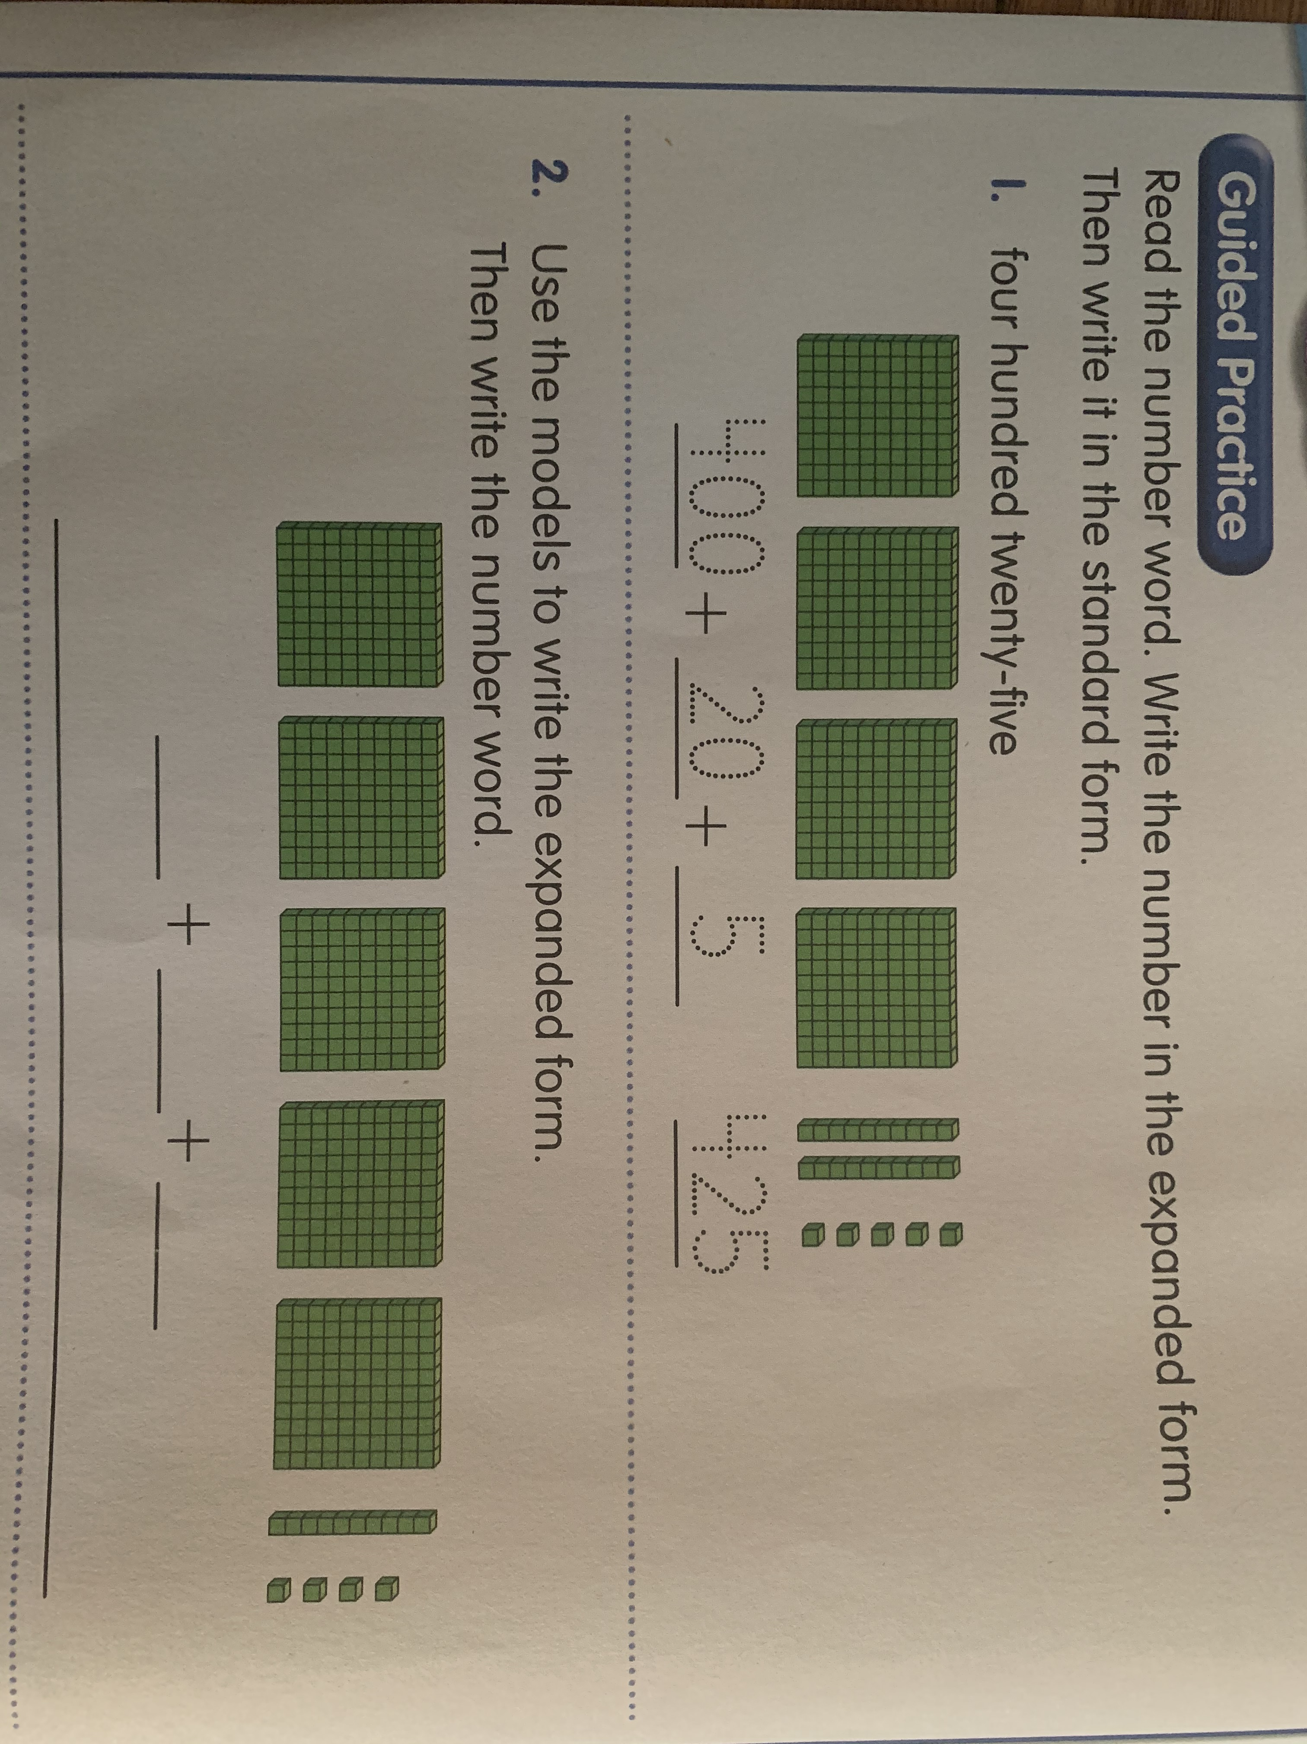
Solve these problems on a separate piece of paper.

Slide 11
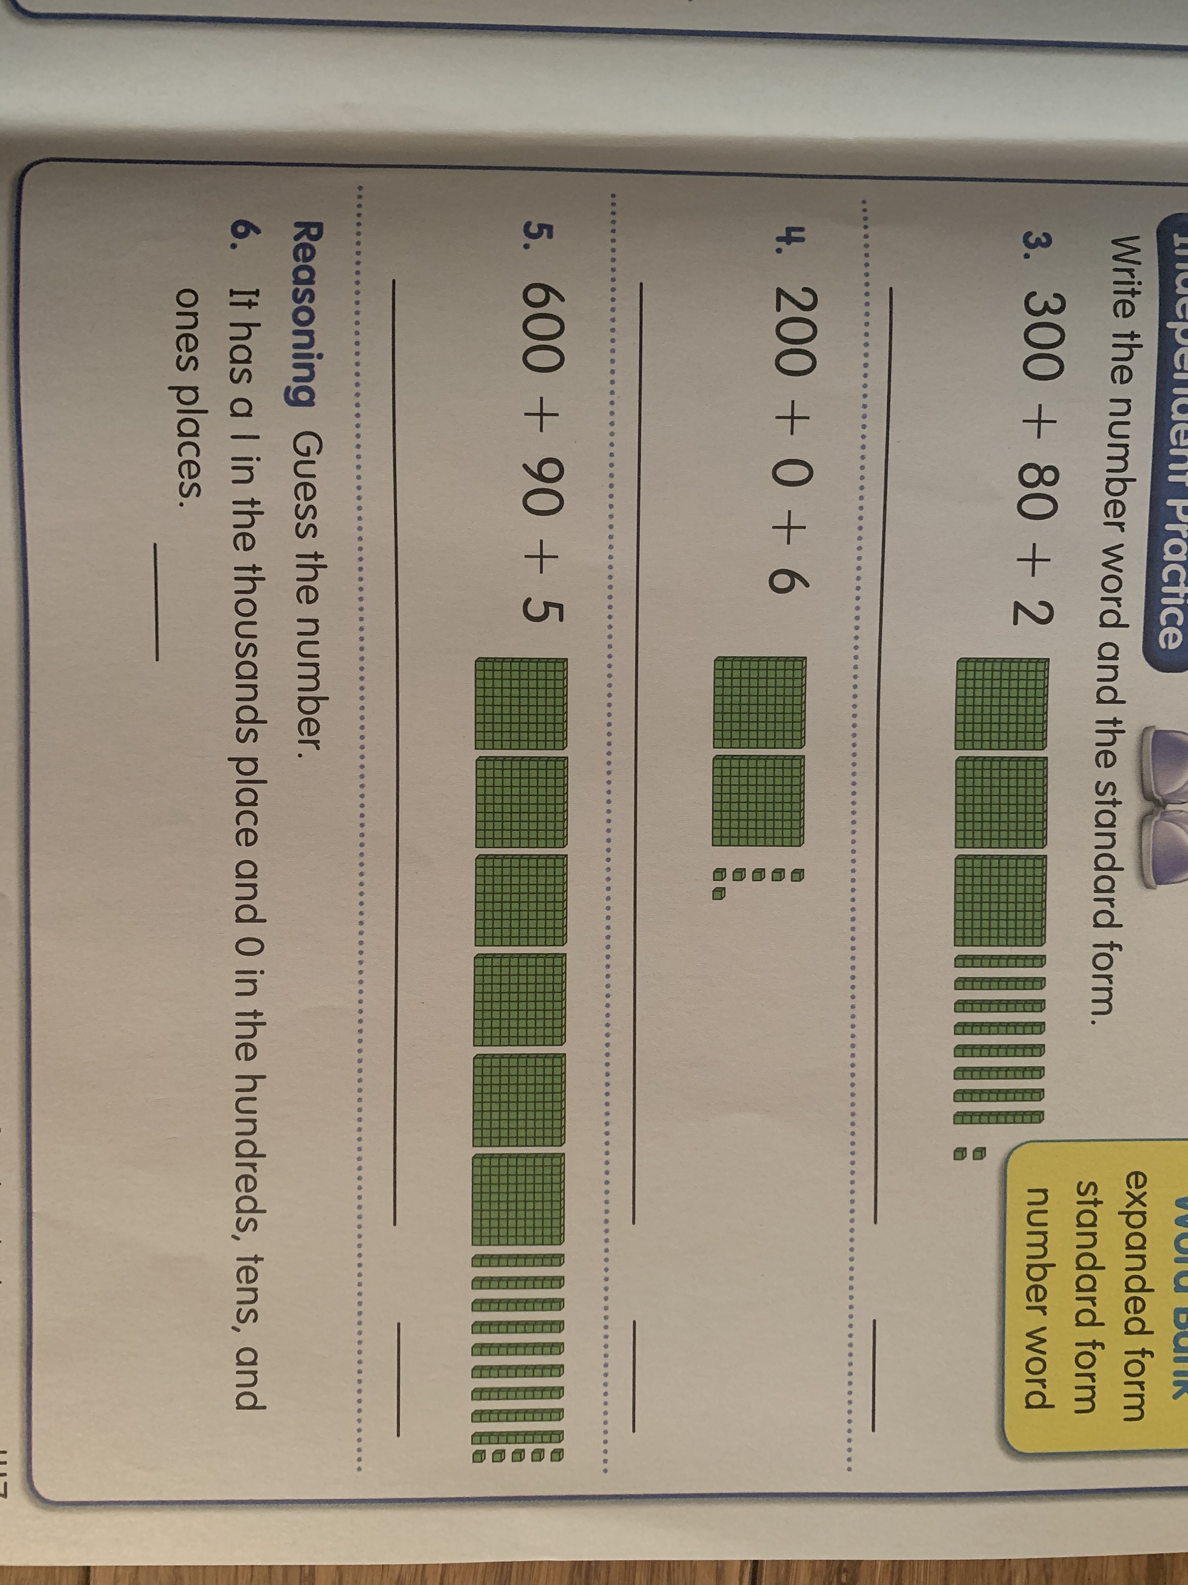

Slide 12
